Slide 1
Perception of risk, behavior, and COVID transmission dynamics
Sarah Nowak and John Hanley
May 13, 2021

Slide 2
Approaches to Modeling Individual Decisions
Deductive Reasoning
Assumed decision process:
Theory
Hypothesis
Conclusion
Pro: Need to make relatively few assumptions
Con: Assumptions you need to make are fairly unrealistic
Inductive Reasoning
Information
Pattern
Conclusion
Assumed decision process:
Pro: More realistic decision process
Con: May need to make many assumptions; good data are hard to come by

Slide 3
Overview of Our Agent-Based Model

Slide 4
Assumption: At Higher Disease Prevalence, Agents Prefer Lower Densities of People

Slide 5
Observed Behavior Influences Risk Perceptions and Future Behavior

Slide 6
Agents Adapt Their Behavior in Response to How Busy Model Locations Are
Maximum preferred density
Current location visit probability
Agents visit locations more often that are less busy than they are comfortable with
Agents visit locations less more that are less busy than they are comfortable with

Slide 7
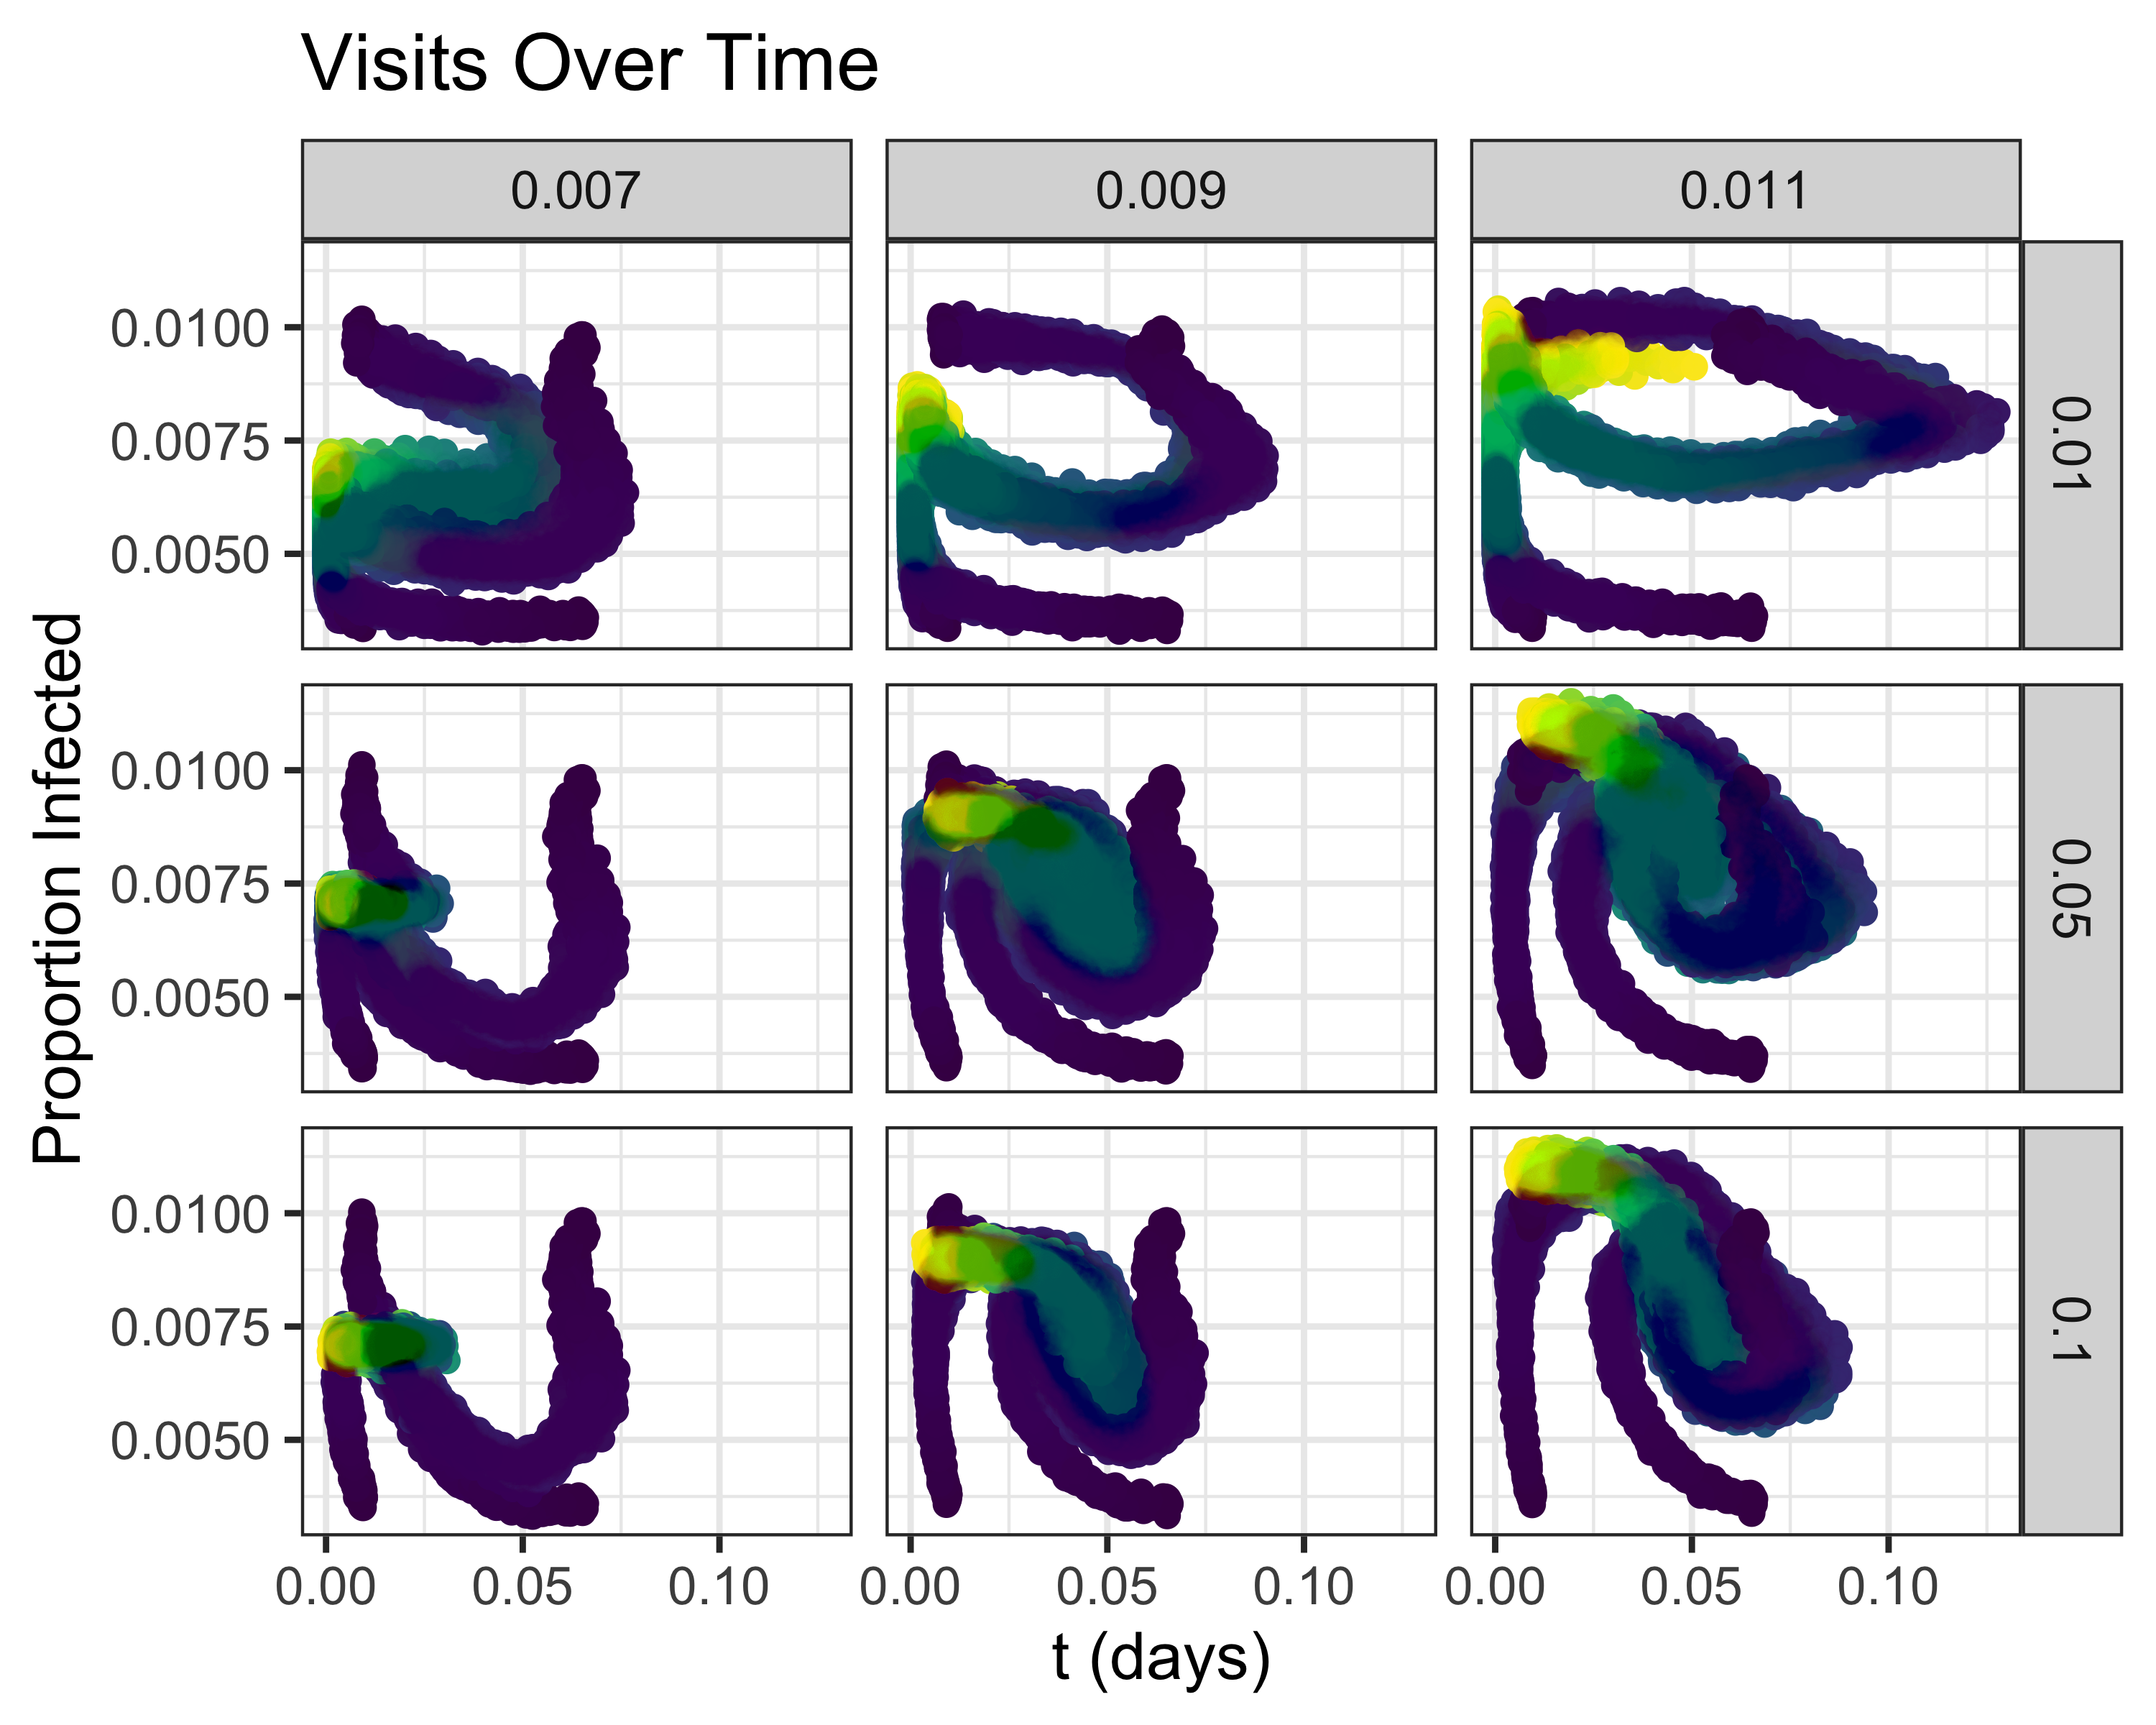
Summary ABM Results
Adaptation threshold
Adaptation rate
Density at Locations
Proportion infected

Slide 8
16 Reasons To Model Other Than Prediction
Explain (very distinct from predict)​ | Offer crisis options in near-real time​
Guide data collection​ | Demonstrate tradeoffs/suggest efficiencies​
Illuminate core dynamics​ | Challenge the robustness of prevailing theory through perturbations​
Suggest dynamical analogies​ | Expose prevailing wisdom as incompatible with available data​
Discover new questions​ | Train practitioners​
Promote a scientific habit of mind​ | Discipline the policy of dialogue​
Bound (bracket) outcomes to plausible ranges​ | Educate the general public​
Illuminate core uncertainties​ | Reveal the apparently simple (complex) to be complex (simple)​

Slide 9

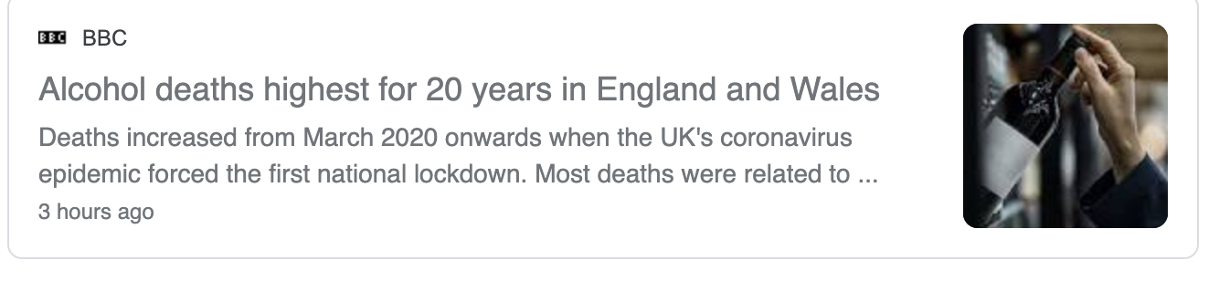
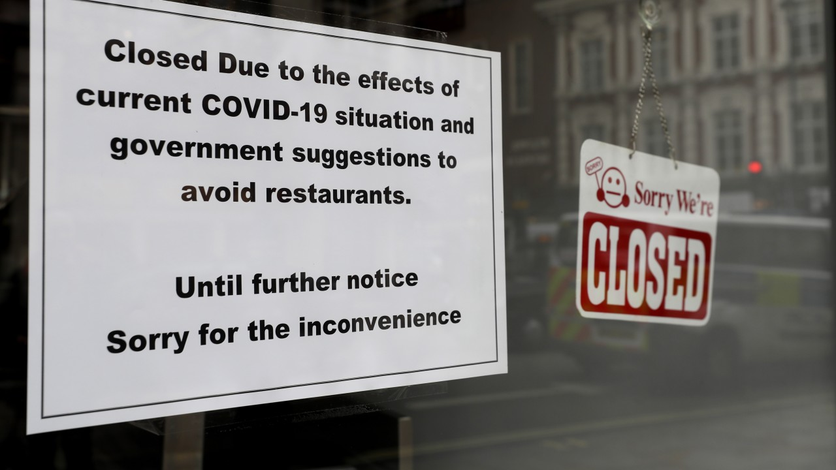
Social Distancing Measures Have Costs

Slide 10
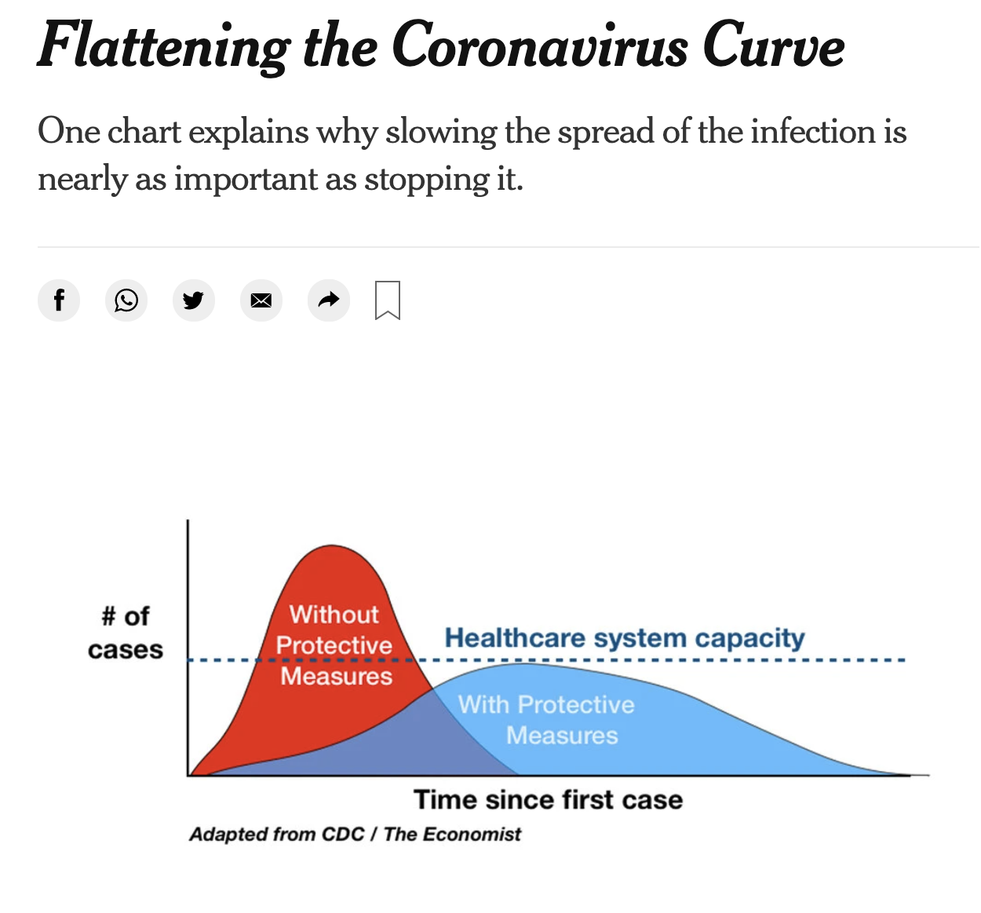
Different Policy Makers Have Different Goals With Social Distancing Measures
Mitigation
Suppression

Slide 11
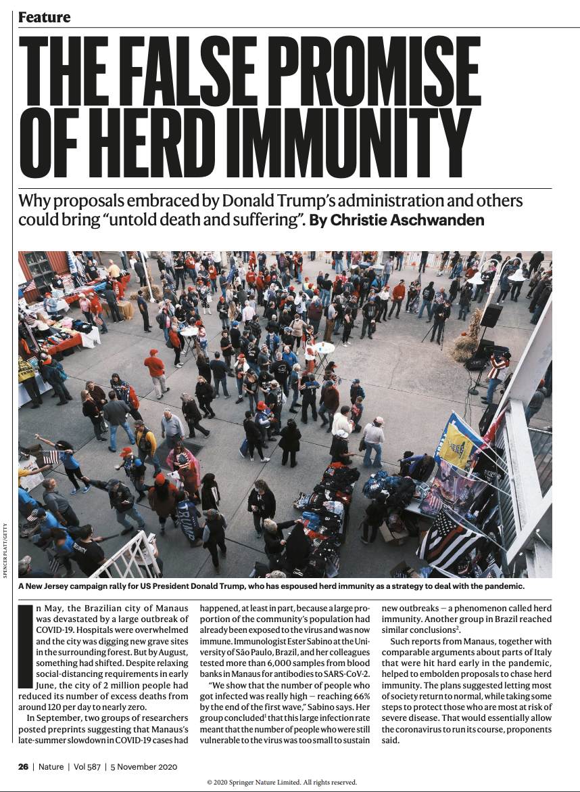
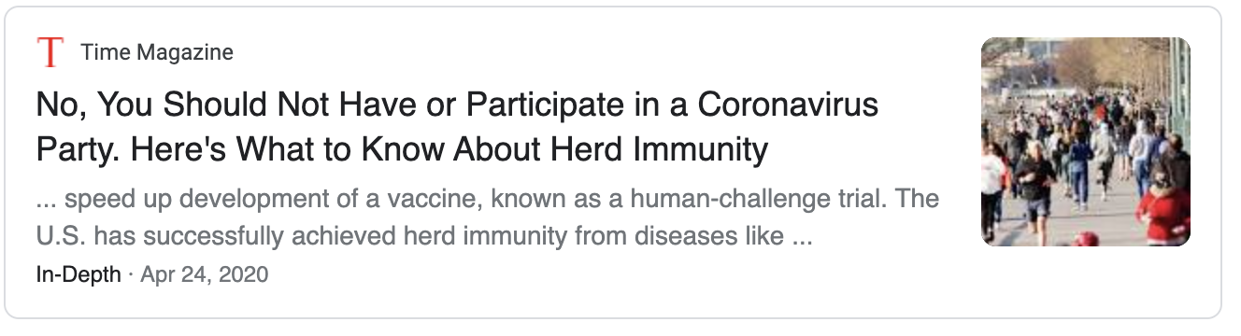
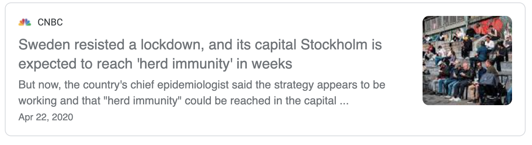
Initially, Some Debates About Herd Immunity Strategies

Slide 12
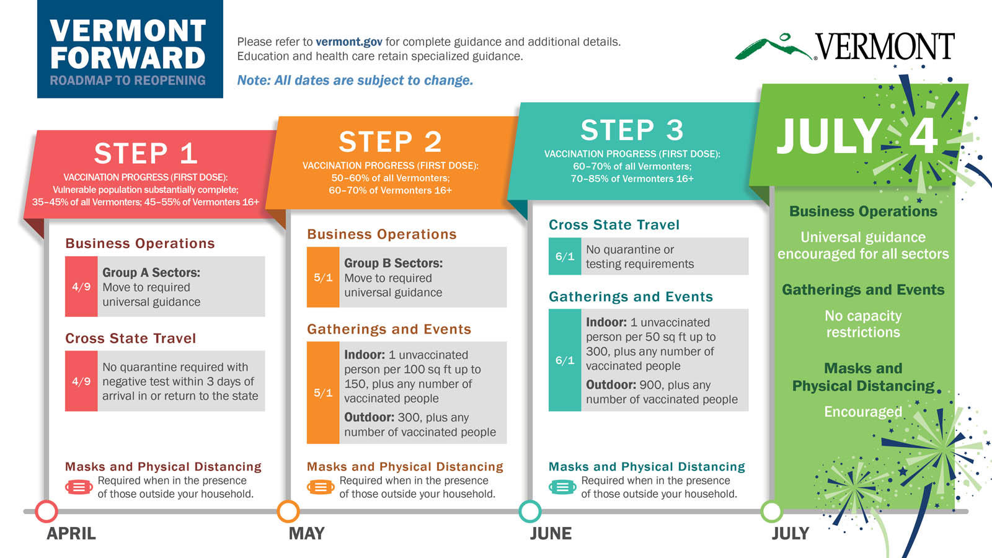

Slide 13
Unanswered Questions
Does a mitigation strategy ever make sense? Under what conditions?
What is the best way to design social distancing strategies to protect vulnerable populations?

Slide 14
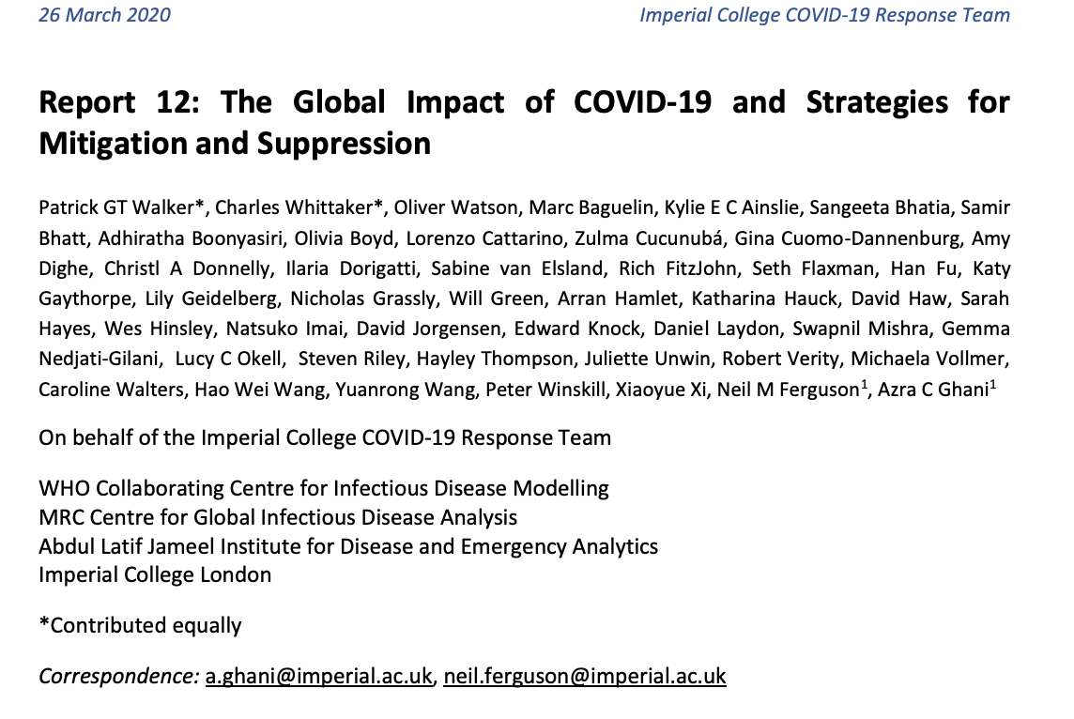
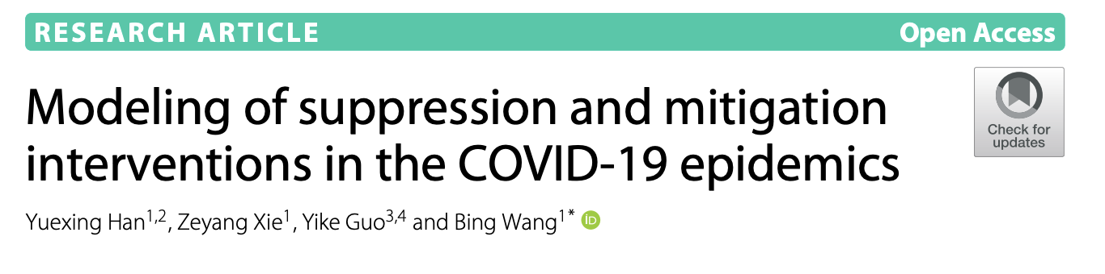
Most COVID-19 Modeling Examines Pre-Specified Policies
Policy Scenarios
Model
Outcomes

Slide 15
With Optimization, Policies Are Not Pre-Specified
Cost Function
Model
Optimal Policy

Slide 16
Optimization (Often) Involves Looking For A Local Maximum or Minimum
In this example, the outcome, z, is a function of two variables: x and y.

Slide 17
Optimizing Social Distancing Policy Is A High-Dimensional Problem
Can choose between different levels of social distancing
Can choose timing of interventions

Slide 18
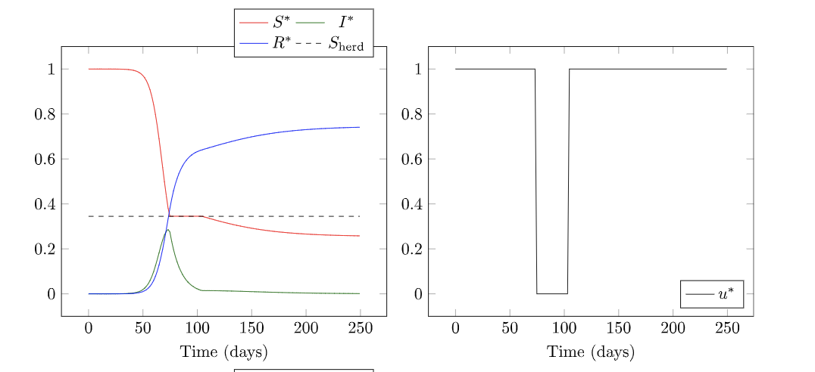
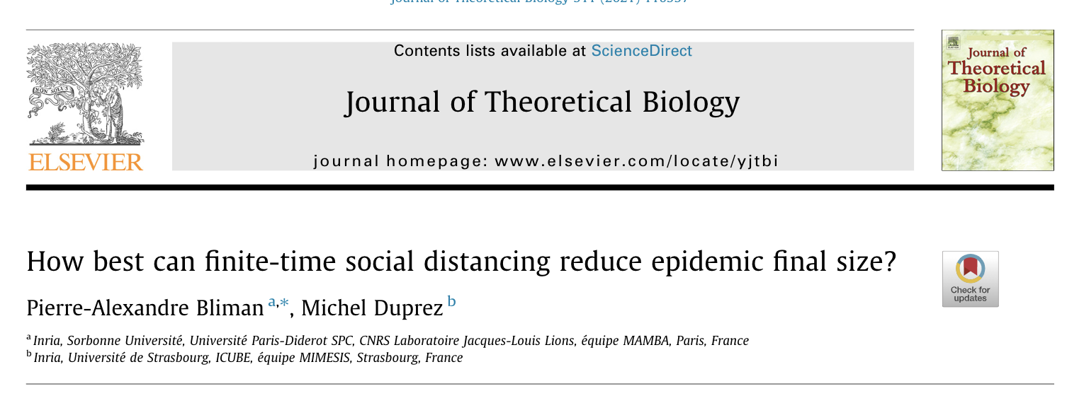
Make the Problem Easier By Simplifying the Problem Space

Slide 19
Calculus of Variations Can Find an Optimal Curve
https://mathematicalgarden.wordpress.com/2014/09/06/soap-film-and-minimal-surface/

Slide 20
Key Model Parameters
Tfinal – how long do you need to use nonpharmaceutical interventions for?
c – Cost of social distancing relative to cost of infections
R0 – Reproduction number
i0 – Initial infections when NPIs are put in place
Note: Model is SIR

Slide 21
The “c” cost of social distancing parameter
Higher c | Lower c
More asymptomatic spread (more difficult to reduce R0) | Easy to identify contagious individuals
Airborne transmission | Limited transmission modes
Less severe illness | More severe illness

Slide 22
Disease Transmission Parameters and Variables
R0 – reproduction number
RD – Social distancing policy we are solving for, variable function of time
Rt – Effective reproduction number, RD*s, accounts for transmission reduction due to social distancing AND recovered individuals

Slide 23
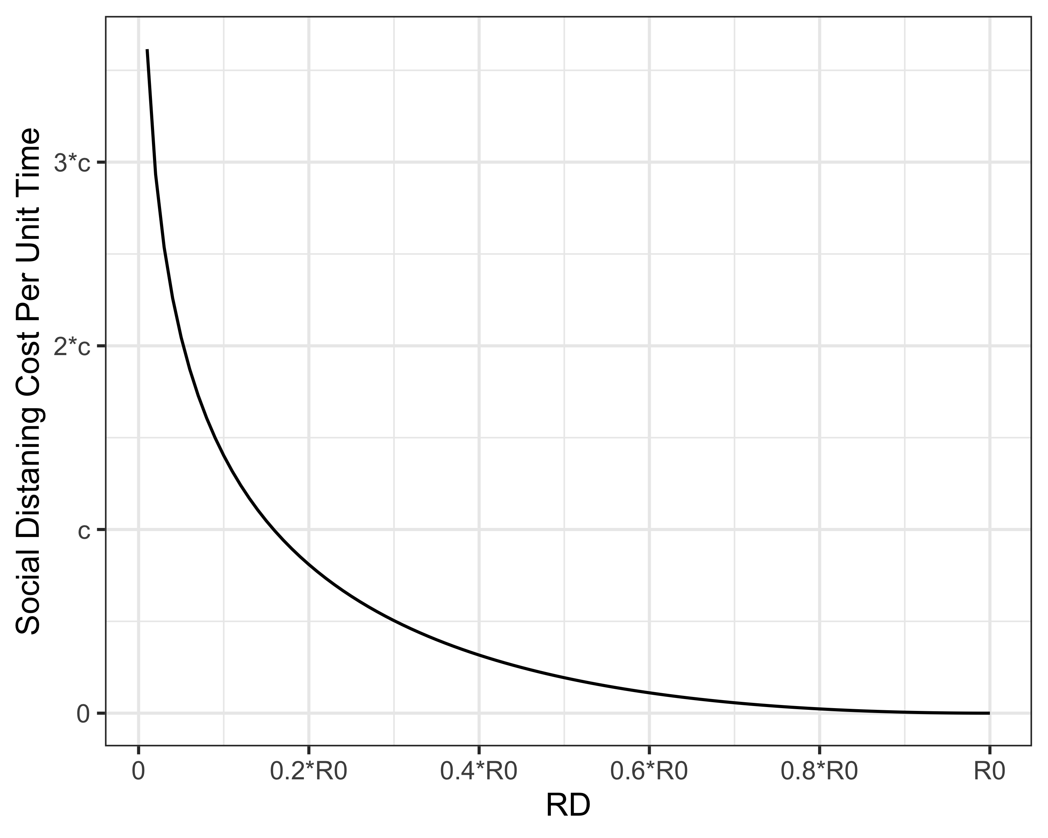
Assumption: Cost of Social Distancing Increases as RD Decreases
Cost to get RD<1 if R0 =5
Cost if R0 =2.5
Cost if R0 =1.5

Slide 24
Final Epidemic Size vs. Min Required for Herd Immunity
 | R0 = 1.5 | R0 = 2.5 | R0 = 5
Uncontrolled final epidemic size | 58% | 89% | 99.3%
Min for herd immunity | 33% | 60% | 80%

Slide 25
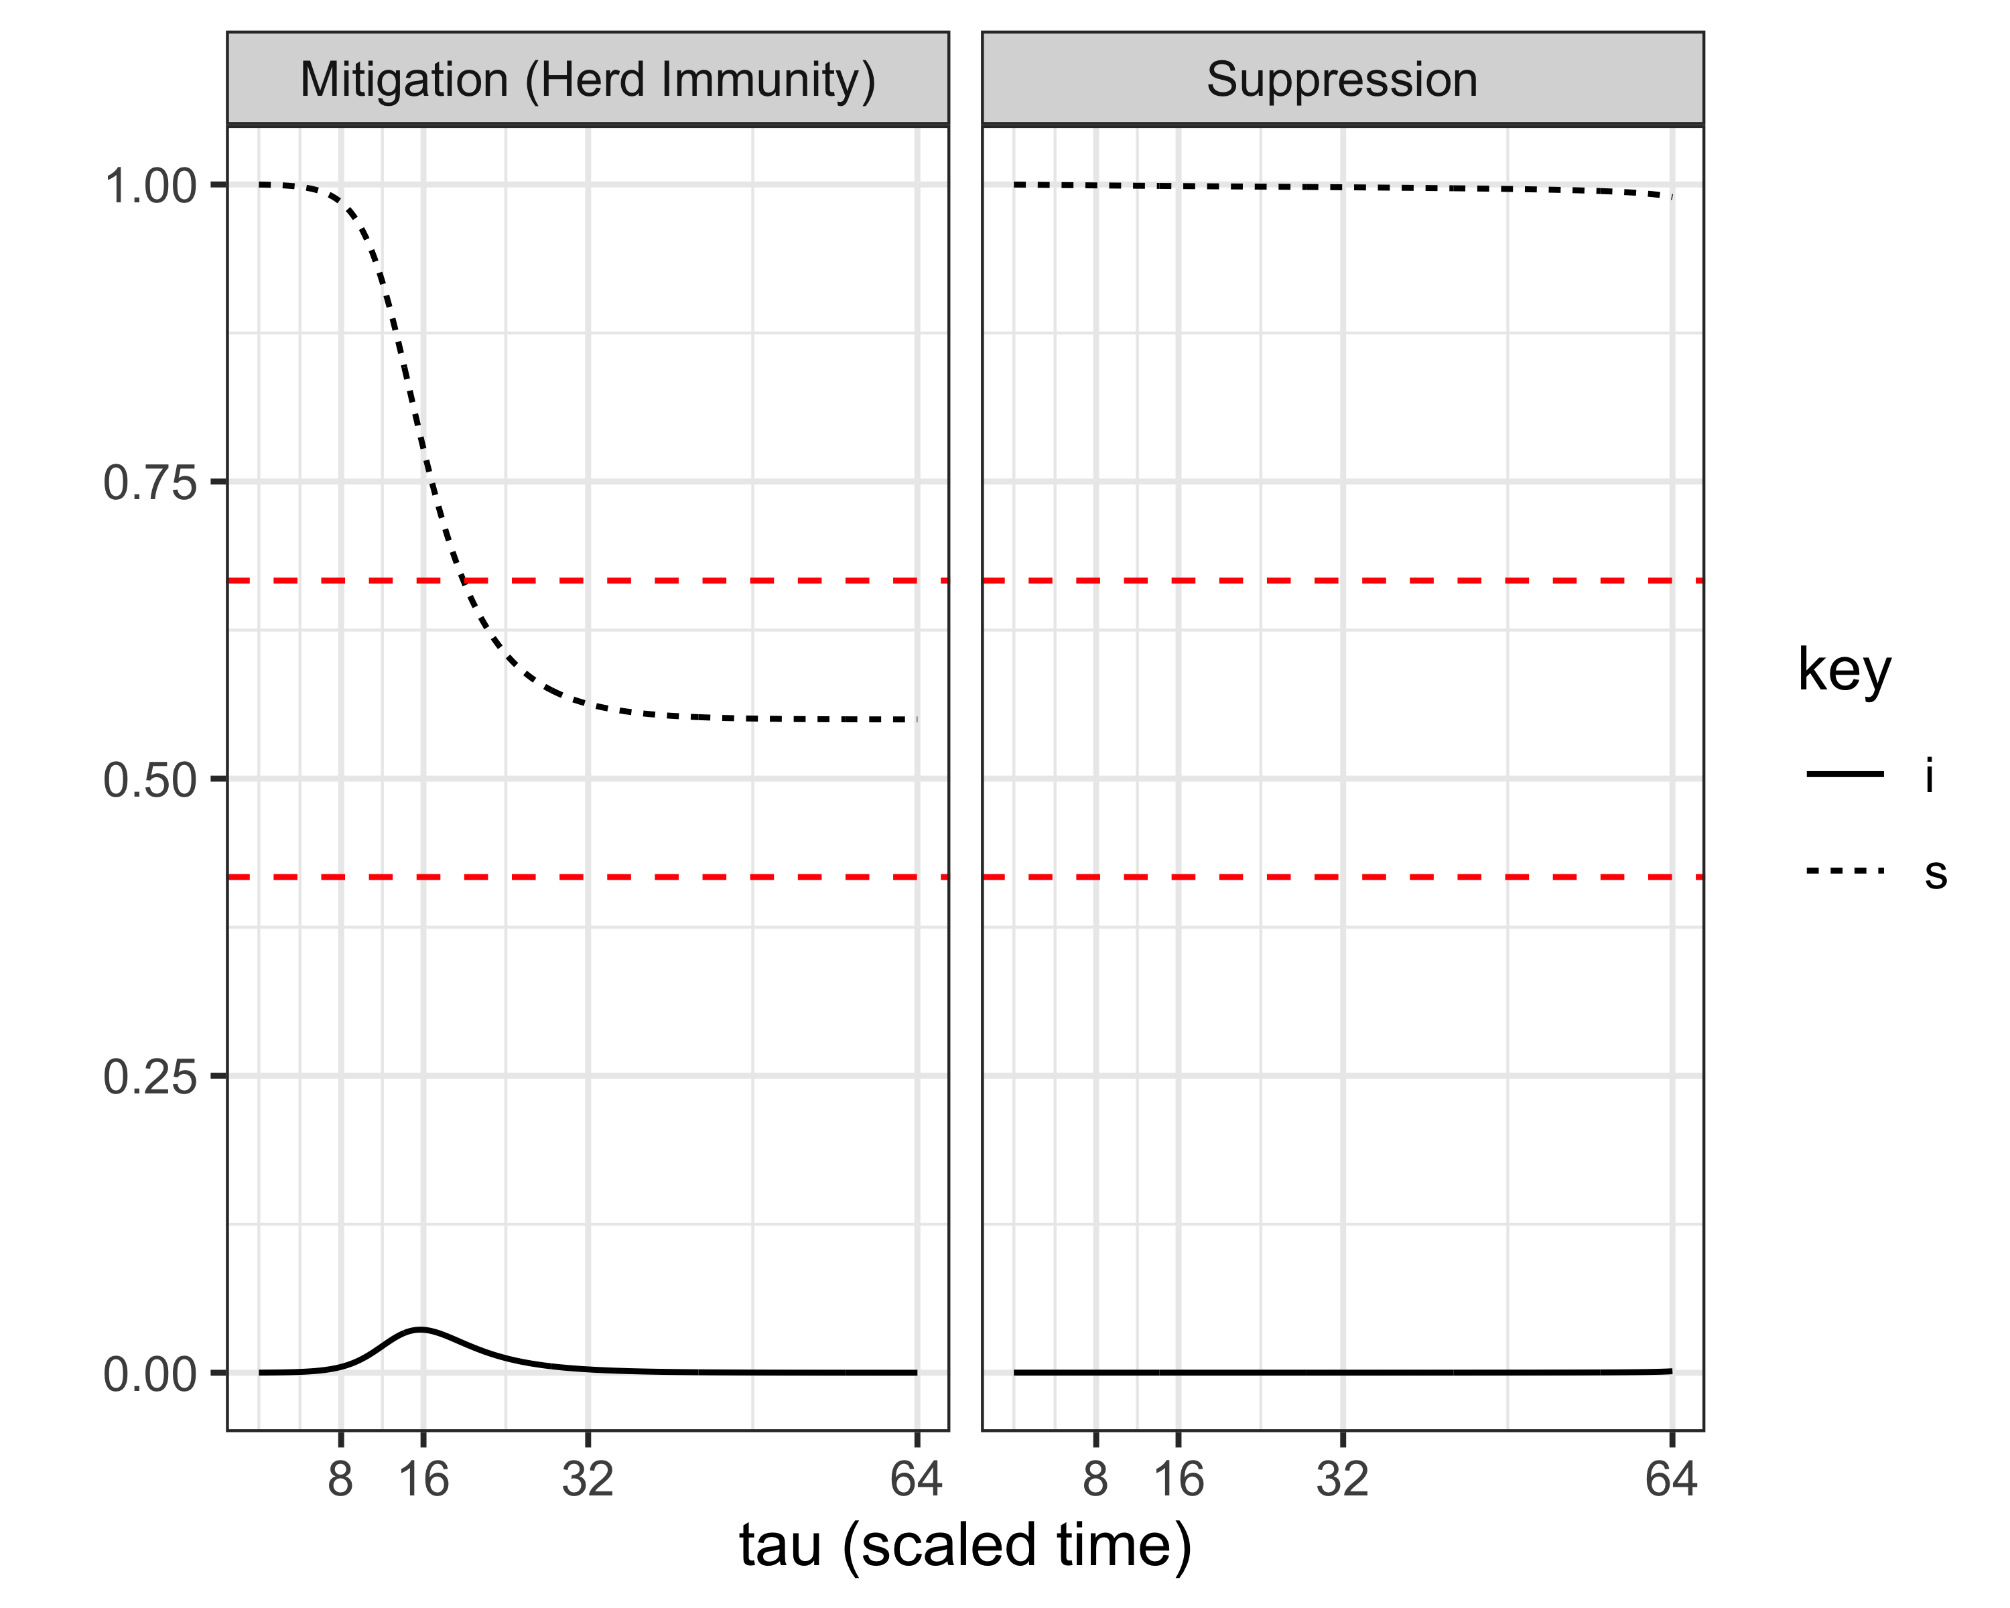
Mitigation (Herd Immunity) vs. Suppression Strategies
Maximum susceptibles for herd immunity
Uncontrolled final epidemic size

Slide 26
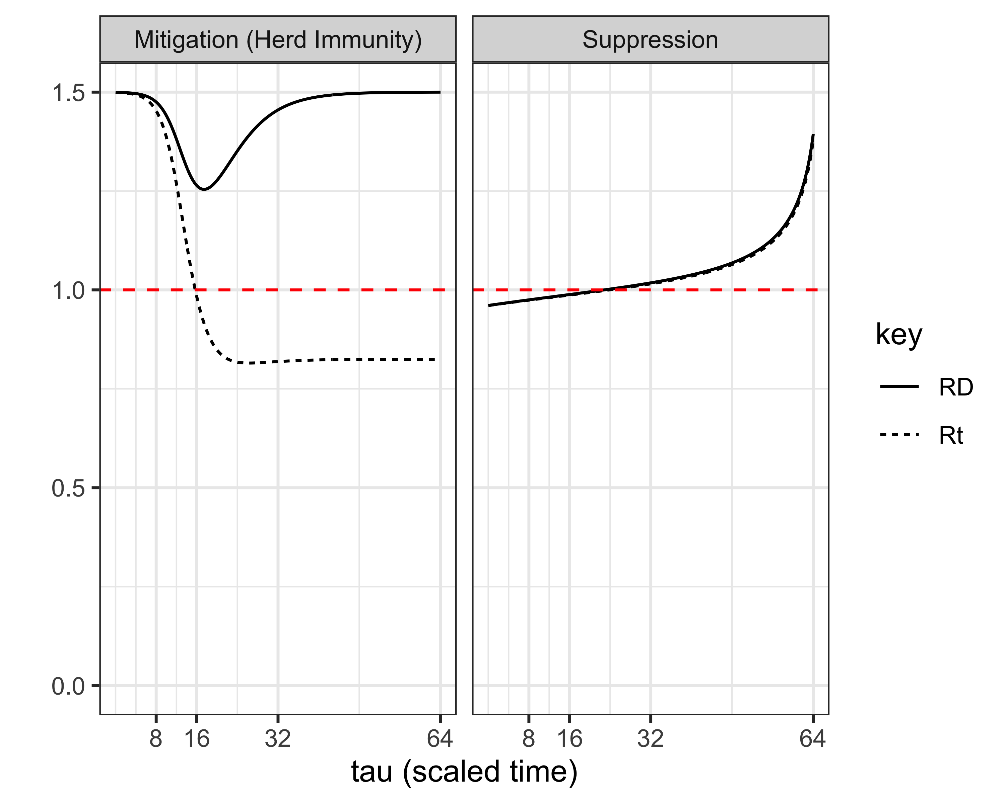
Mitigation (Herd Immunity) vs. Suppression Strategies

Slide 27
Mitigation (Herd Immunity) vs. Suppression Strategies, Summary
 | Mitigation | Suppression
Policy | Delay in “lockdown”, coincides with peak infections, eventual full re-opening | Initial “lockdown” + gradual re-opening
Infections | Substantial number become infected, usual at least enough to lead to herd immunity | Remains very low
Susceptibles | Substantial decline over time | Remains close to total population
Rt (effective reproduction number) | Decreases as a result of decrease in susceptible population and/or social distancing | Decreases as a result of social distancing only

Slide 28
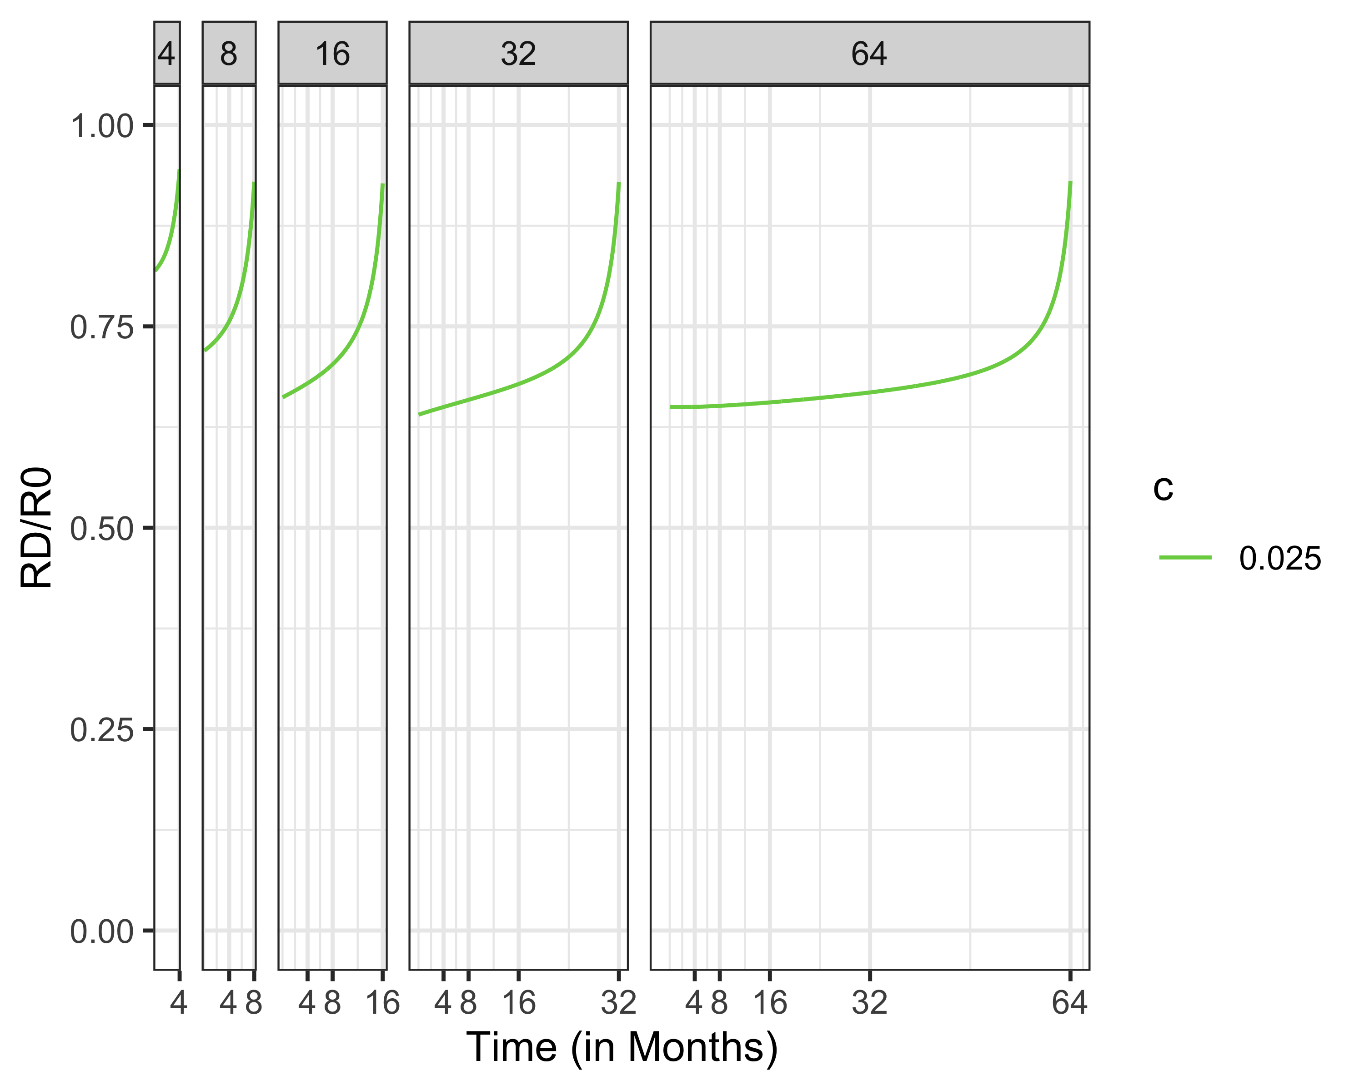
Effect of Tfinal, Length of NPI Period
“It’ll disappear when the weather gets warm”
“It’ll be years until a vaccine”

Slide 29
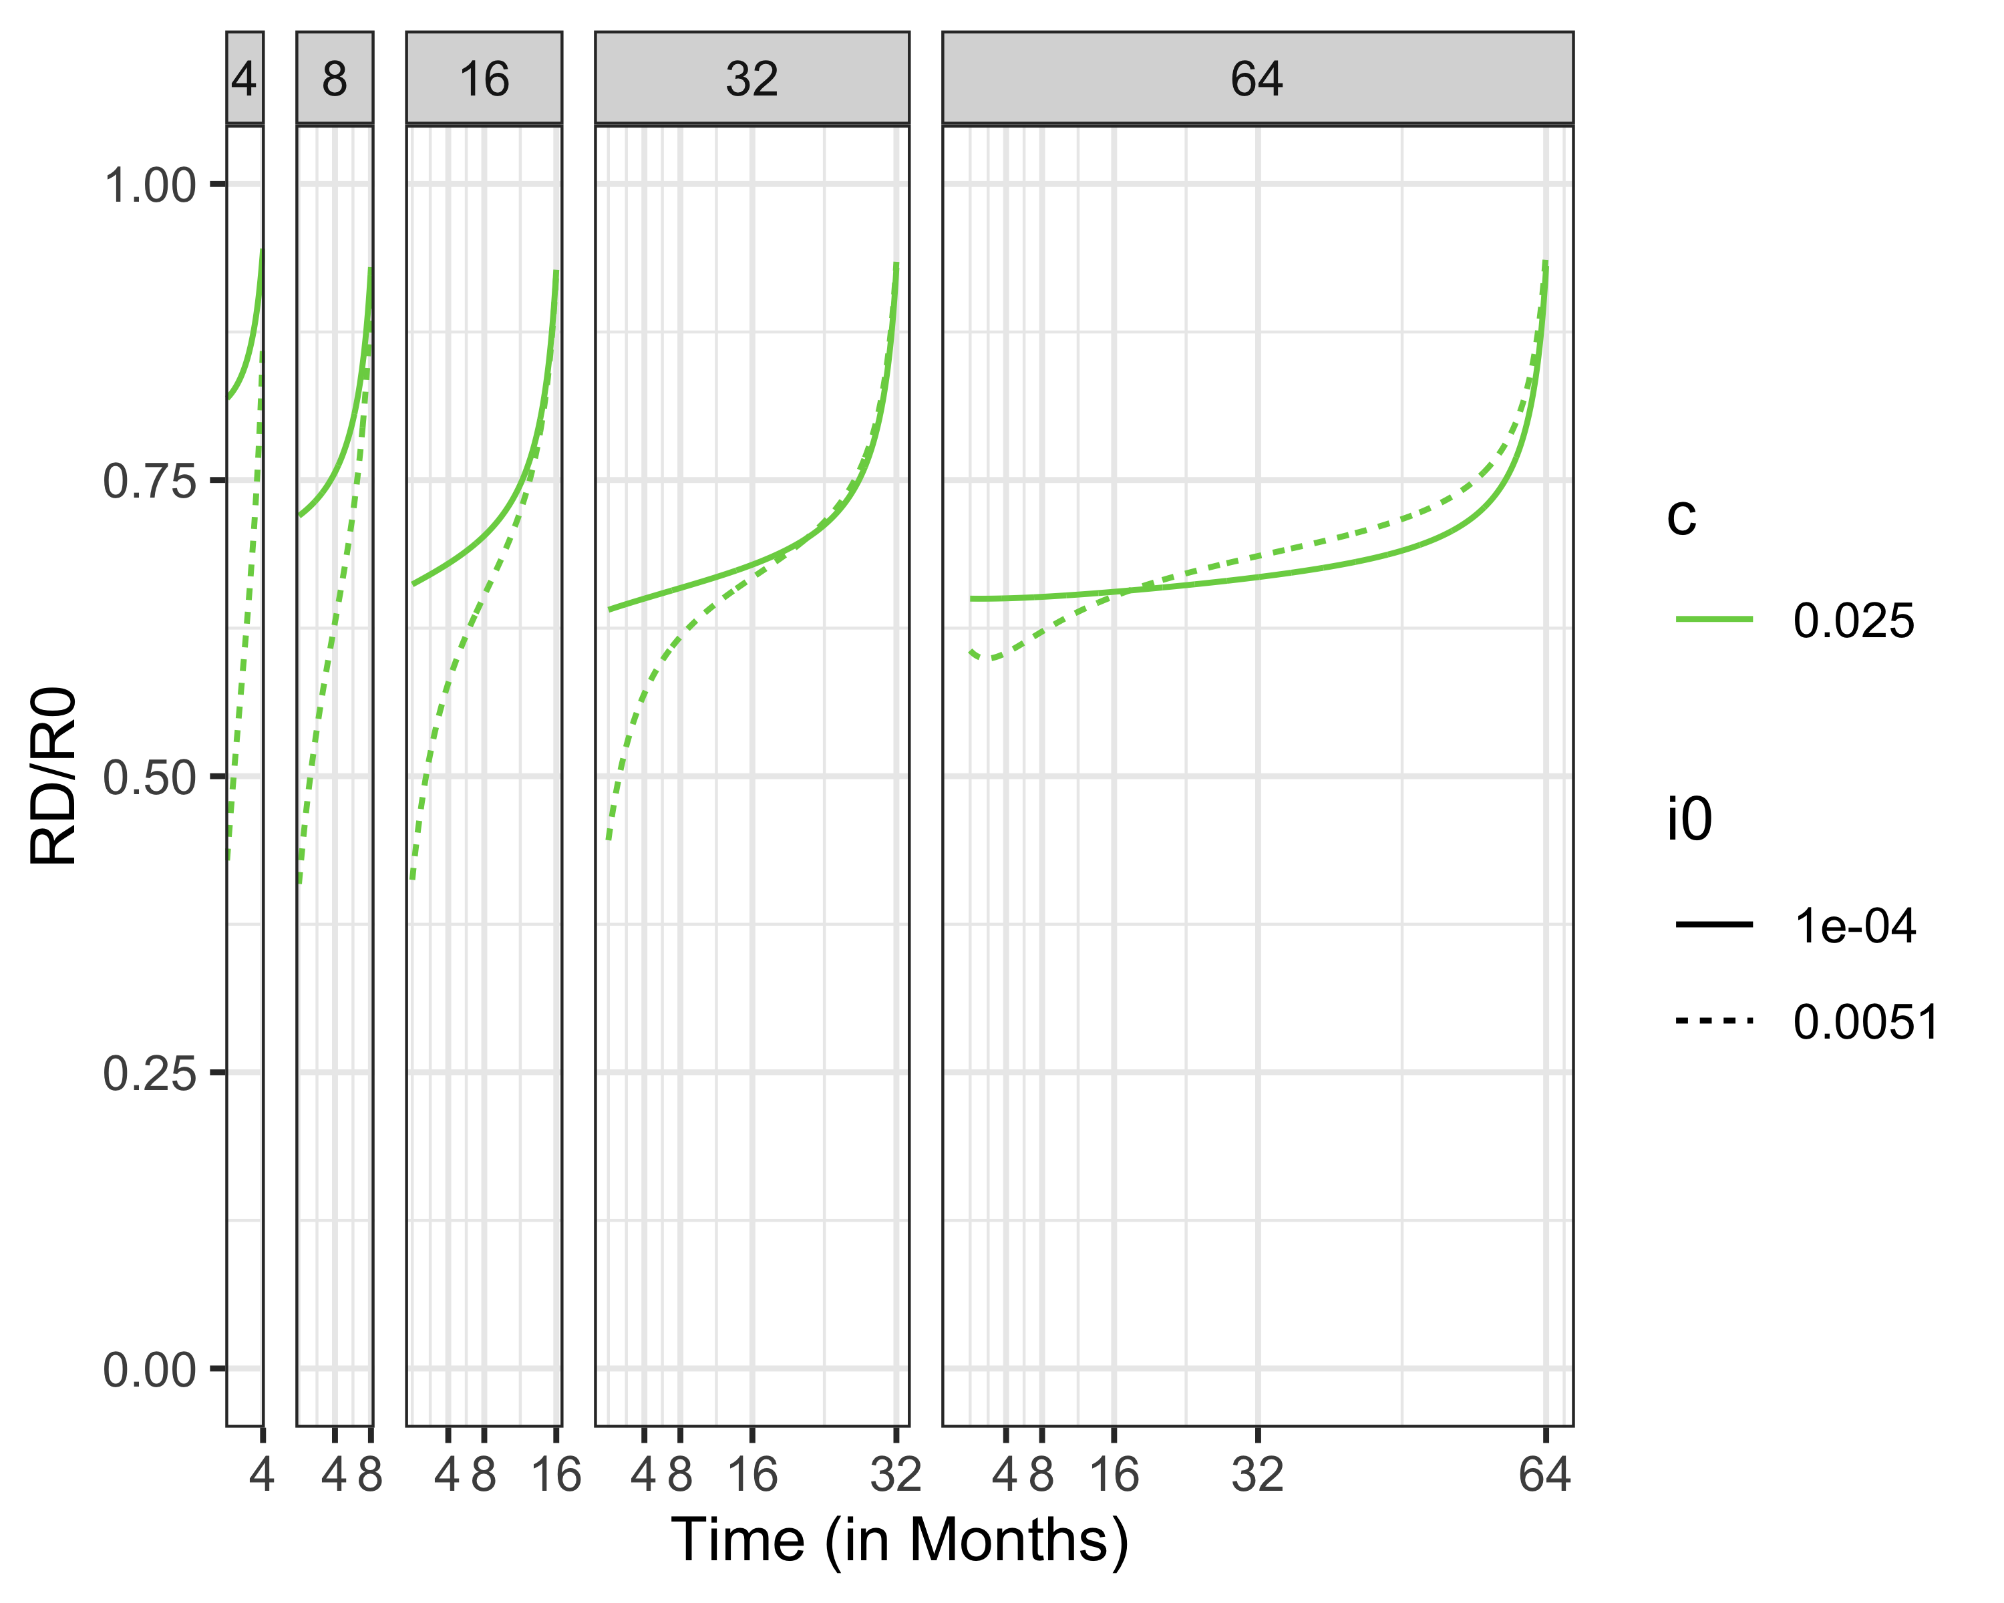
You Need Stricter Lockdowns For Higher Initial Infection Sizes

Slide 30
Social Distancing Policies at Low (Relative) Social Distancing Cost

Slide 31
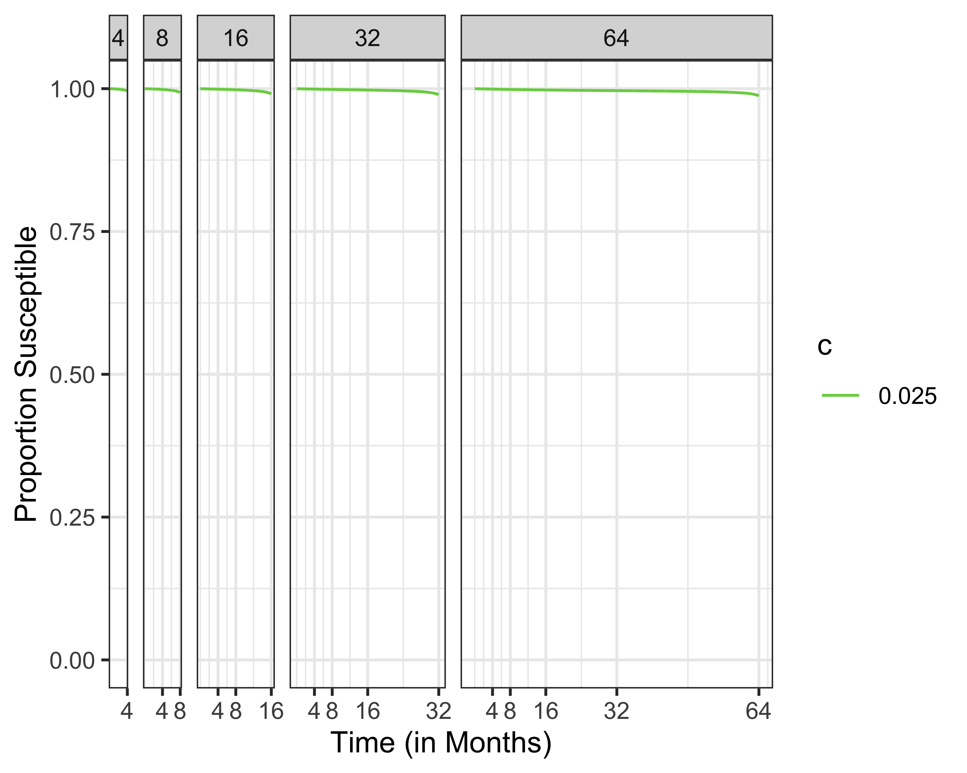
Susceptibles at Low (Relative) Social Distancing Cost

Slide 32
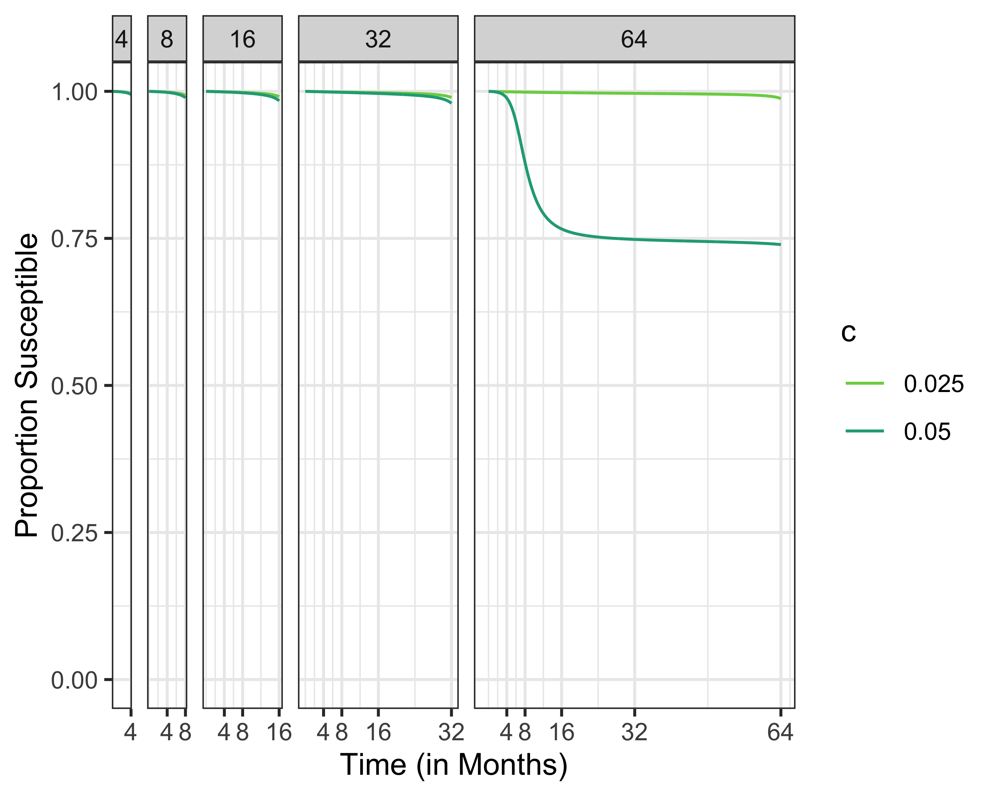
Proportion Susceptible, Increasing Social Distancing Cost

Slide 33
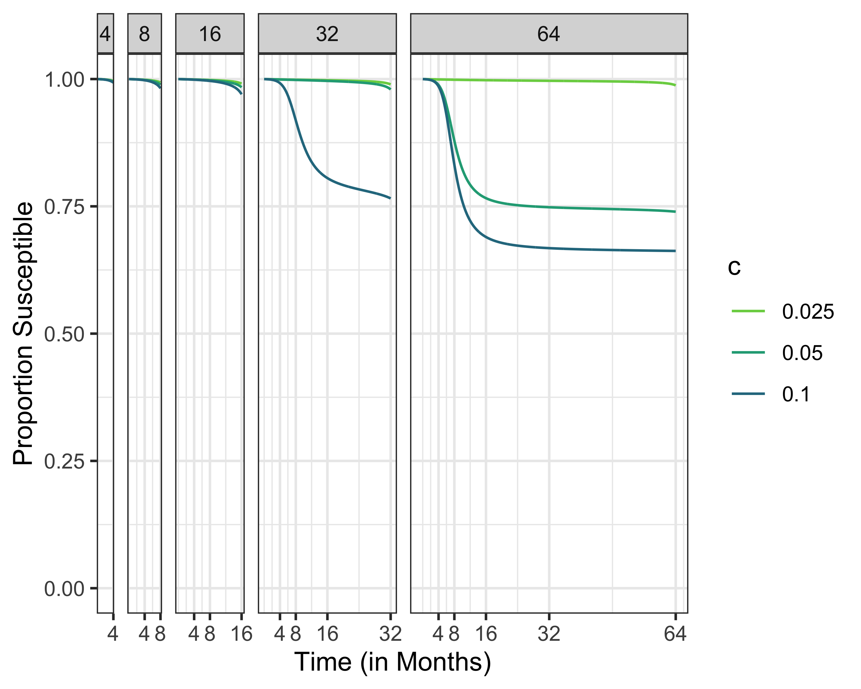
Susceptibles Different Time Horizons

Slide 34
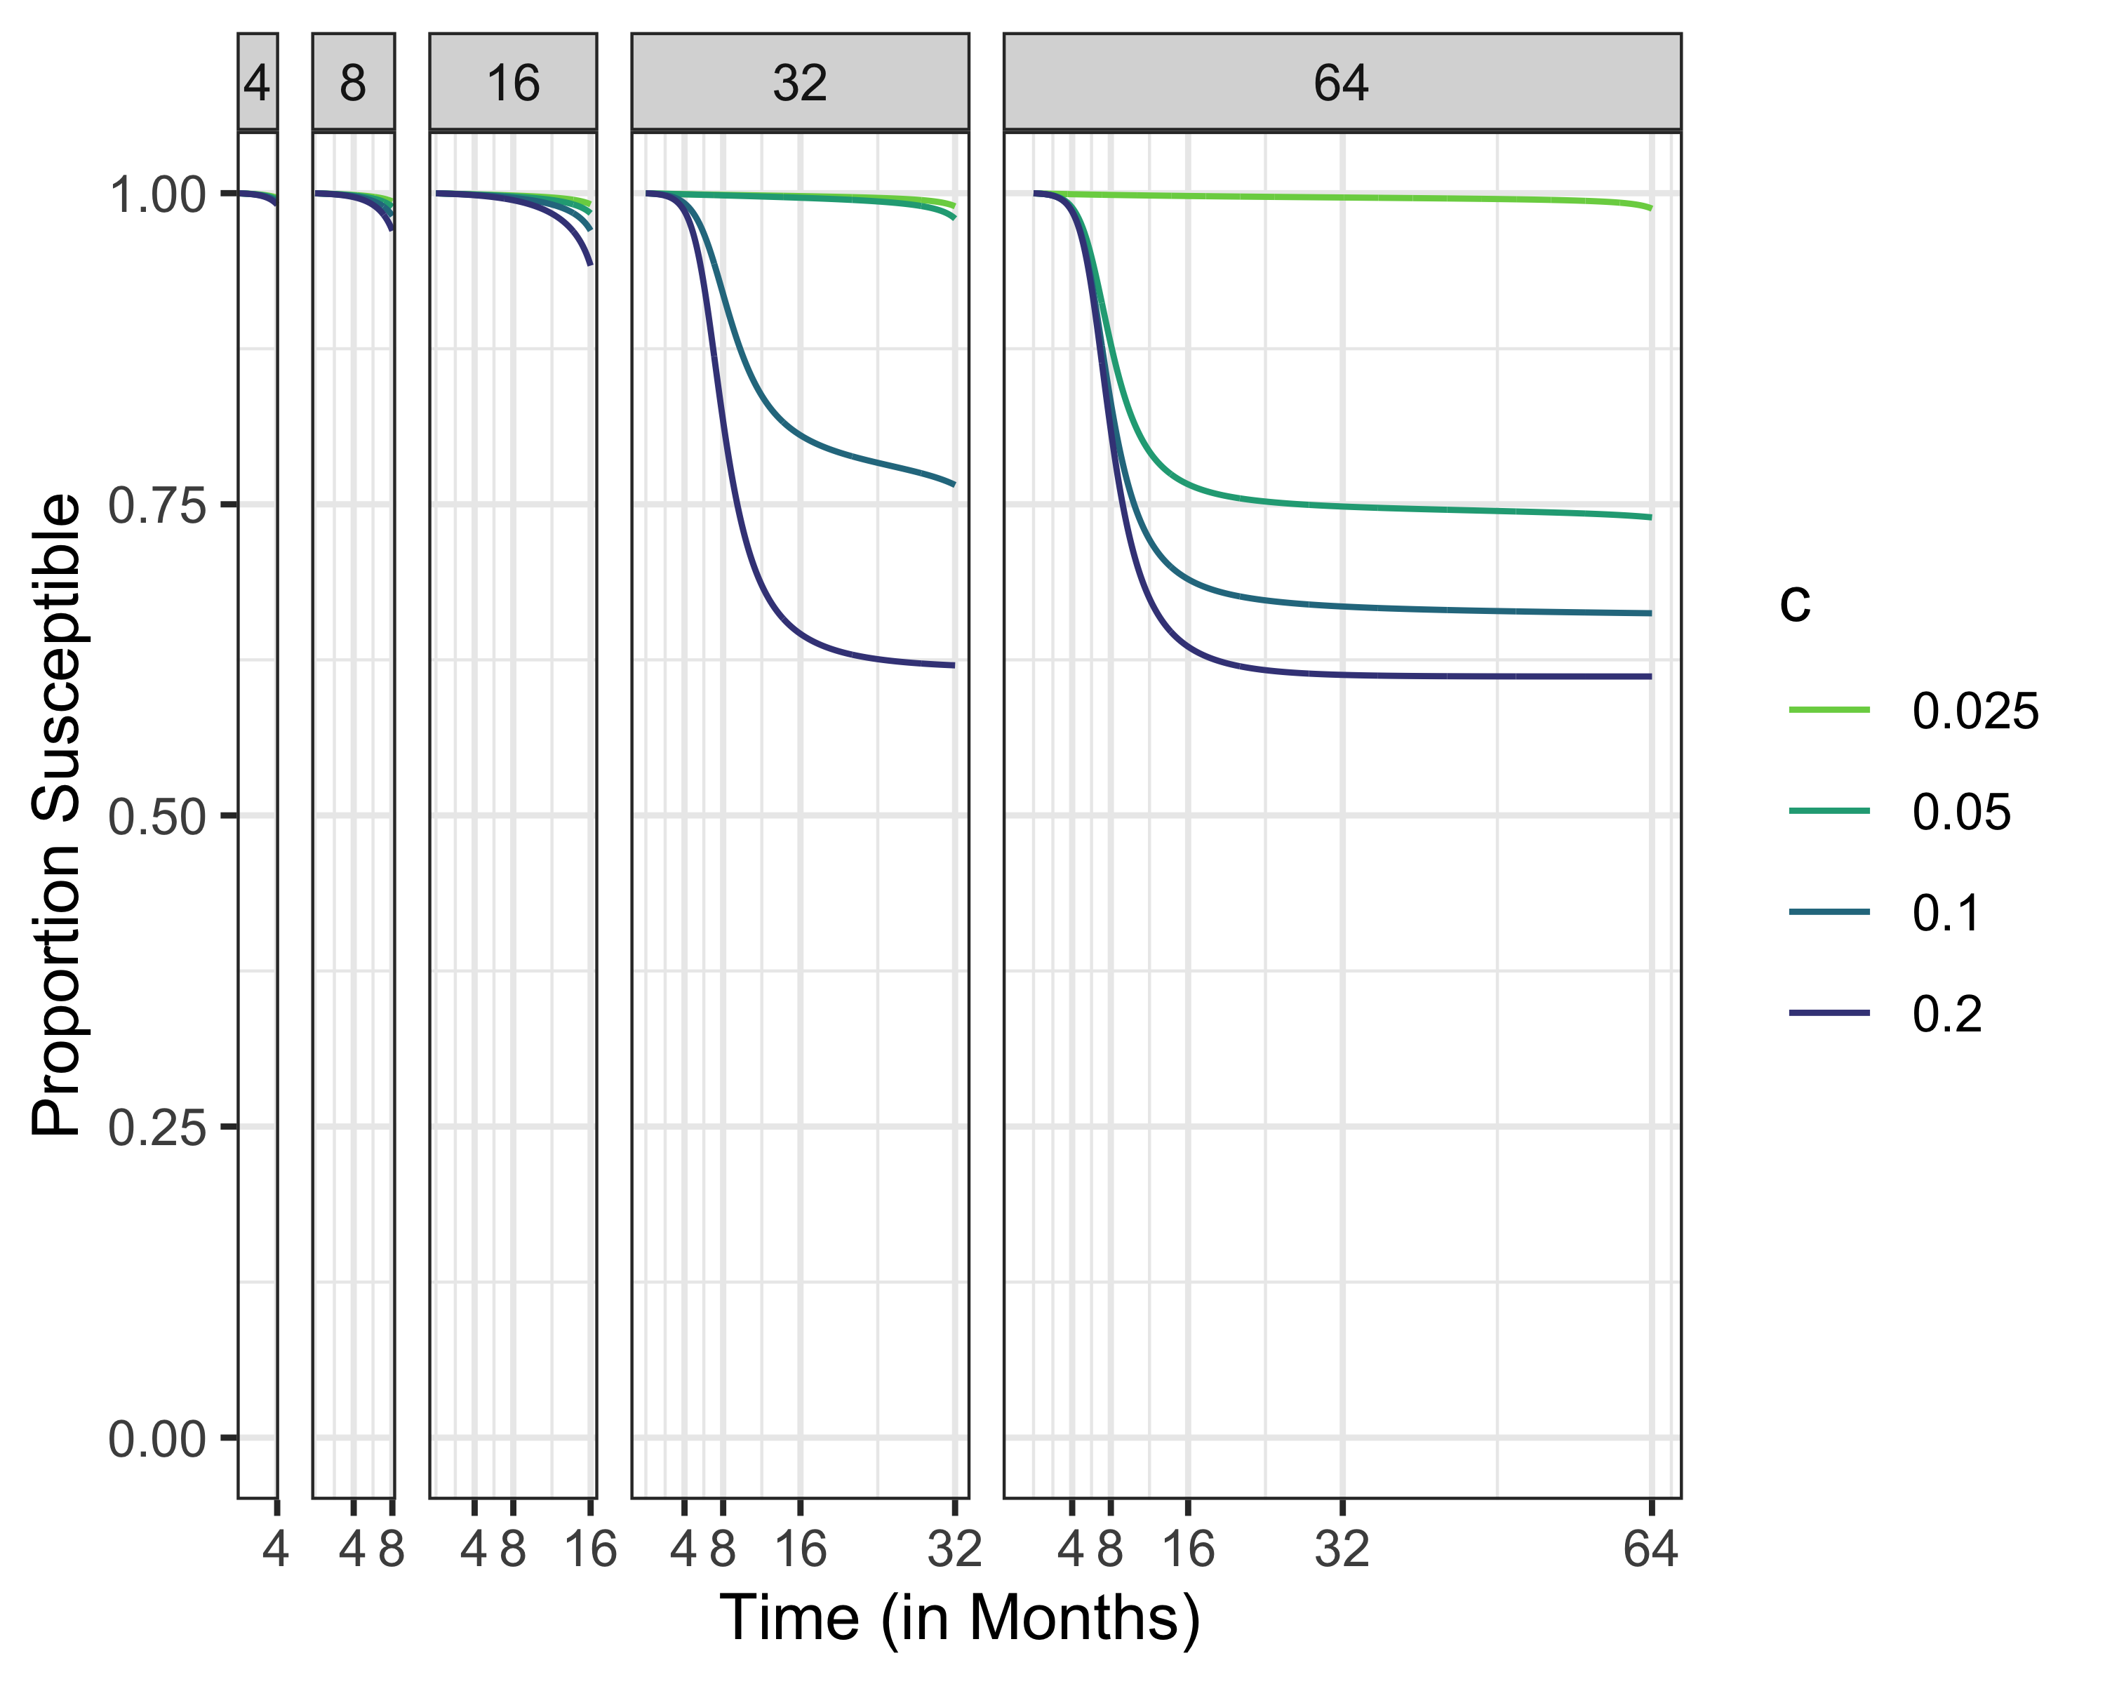
Susceptibles Different Time Horizons

Slide 35
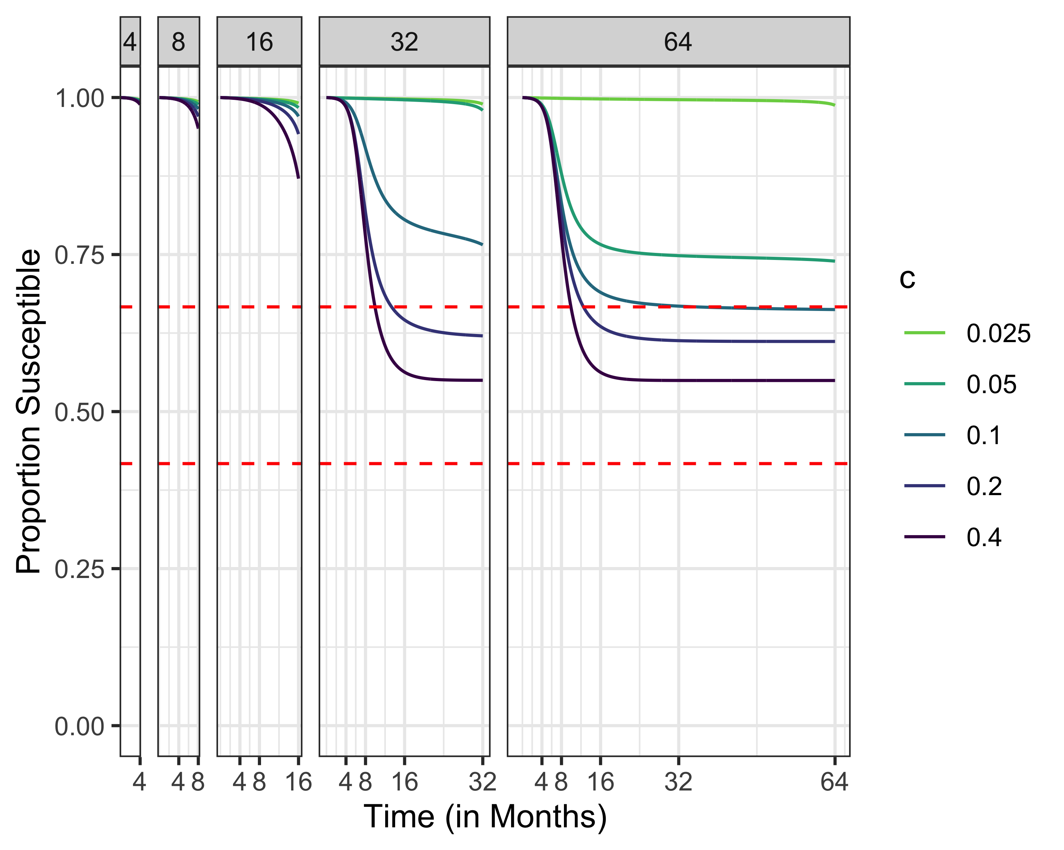
Susceptibles, R0 = 1.5
Maximum susceptibles for herd immunity
Uncontrolled final epidemic size

Slide 36
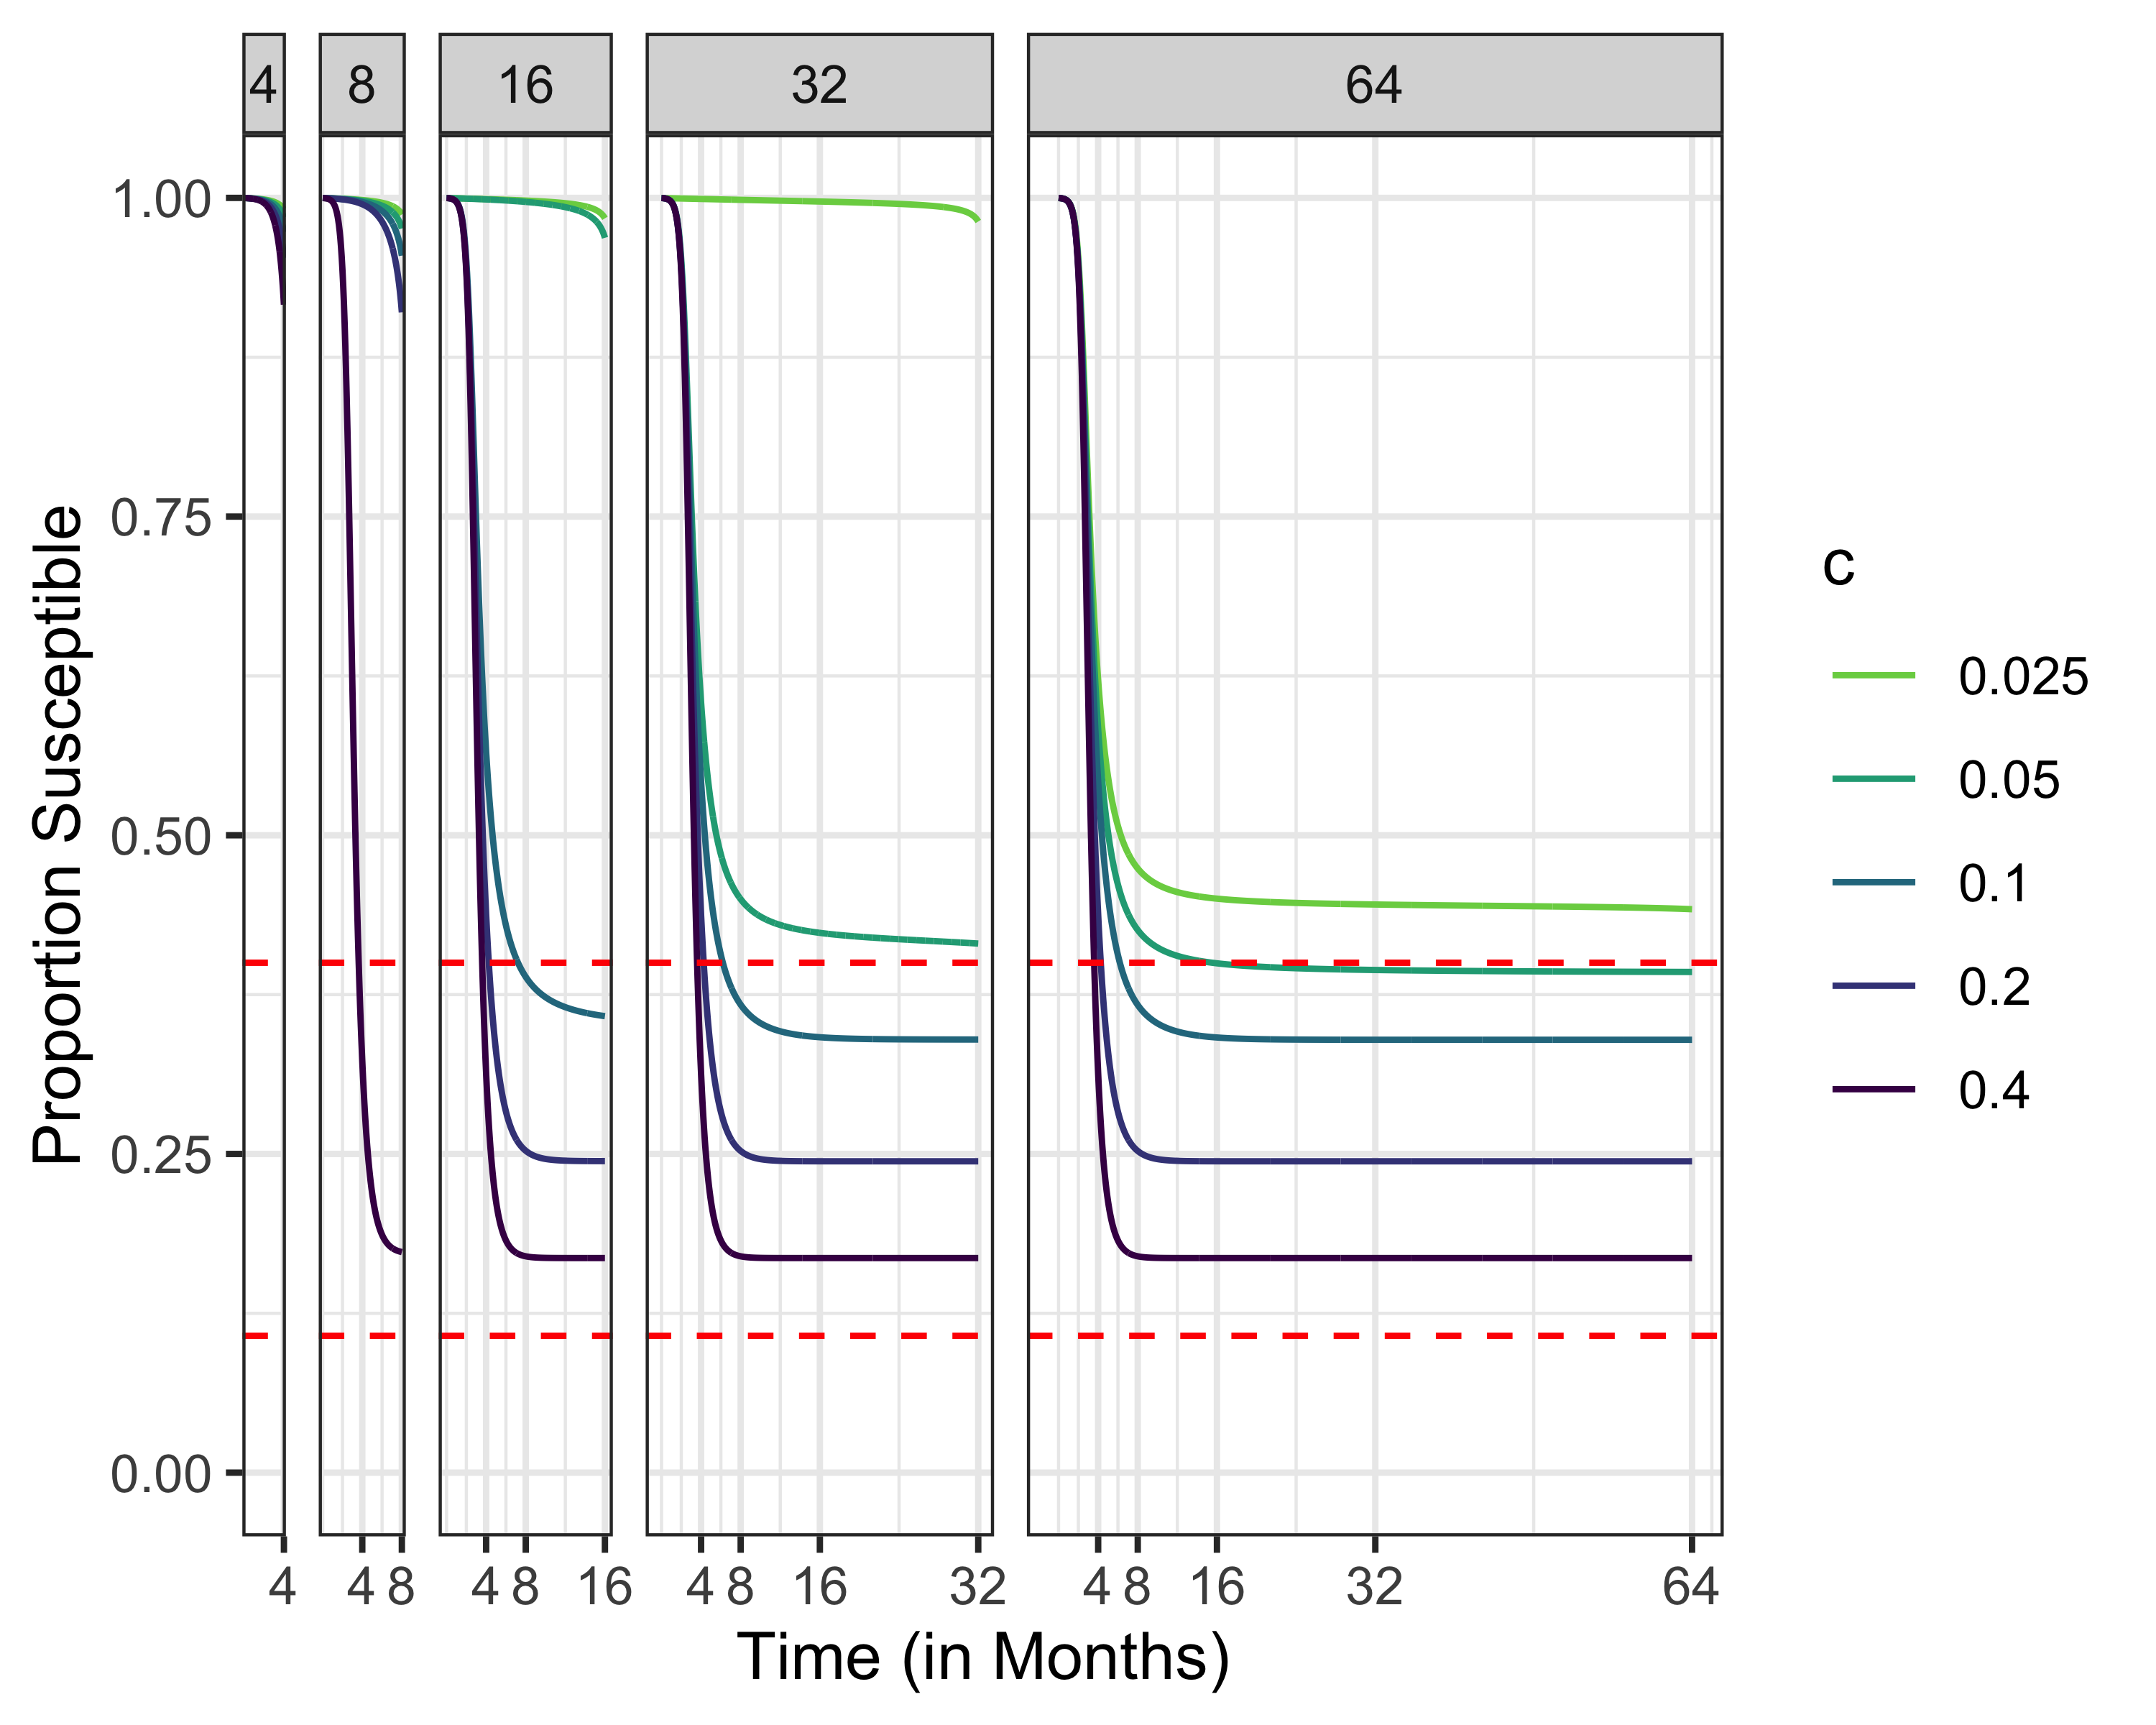
Susceptibles, R0 = 2.5
Maximum susceptibles for herd immunity
Uncontrolled final epidemic size

Slide 37
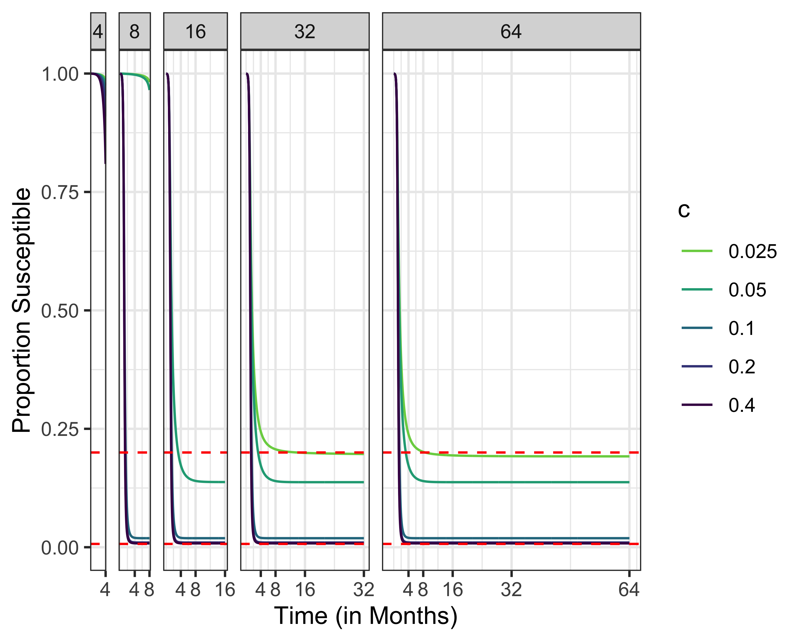
Susceptibles, R0 = 5
Maximum susceptibles for herd immunity
Uncontrolled final epidemic size

Slide 38
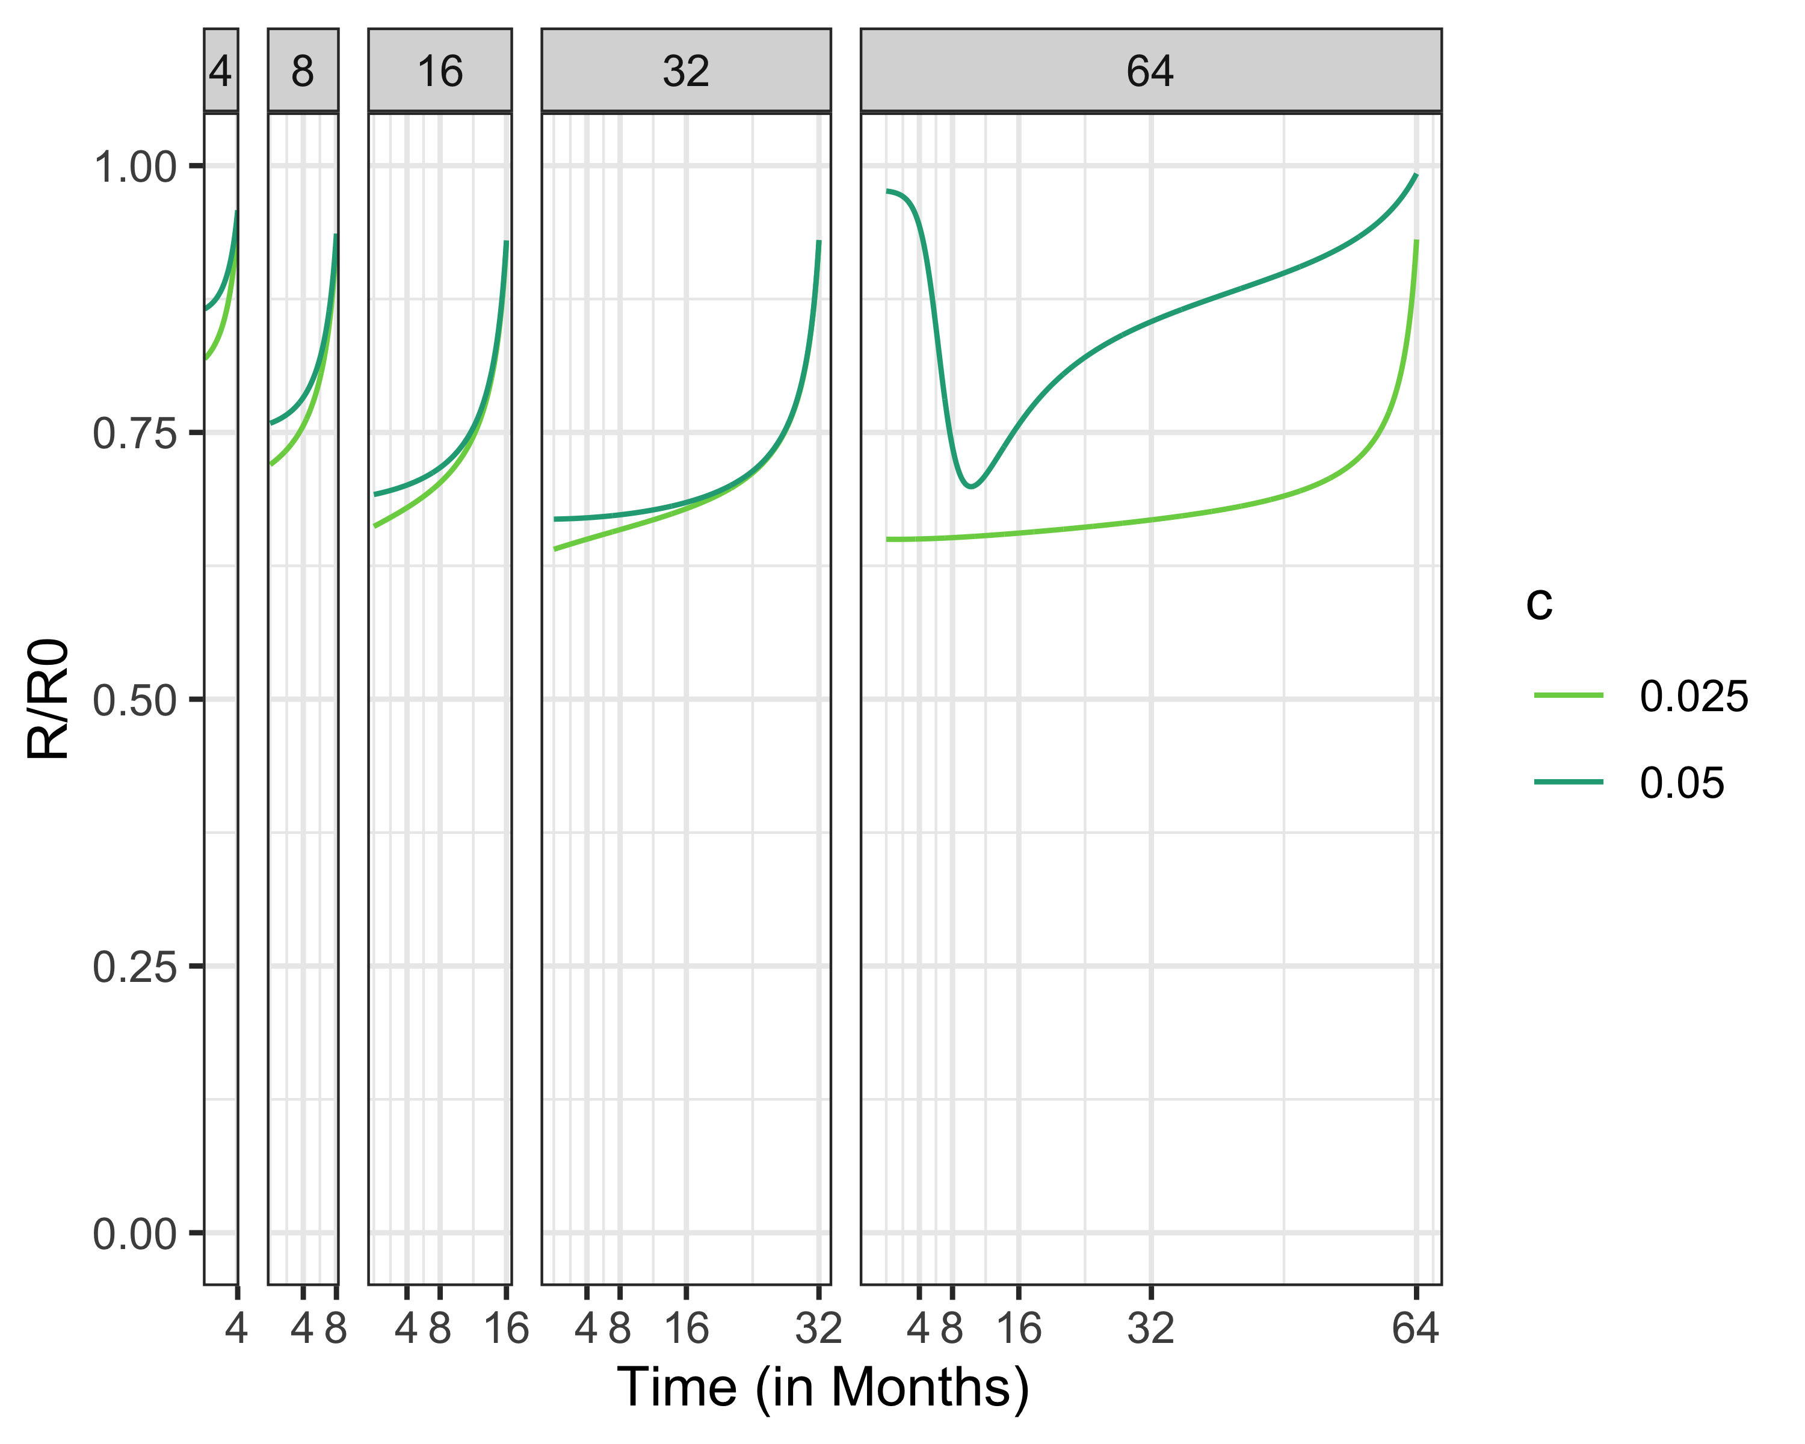
Social Distancing Policies, Increasing Social Distancing Cost

Slide 39
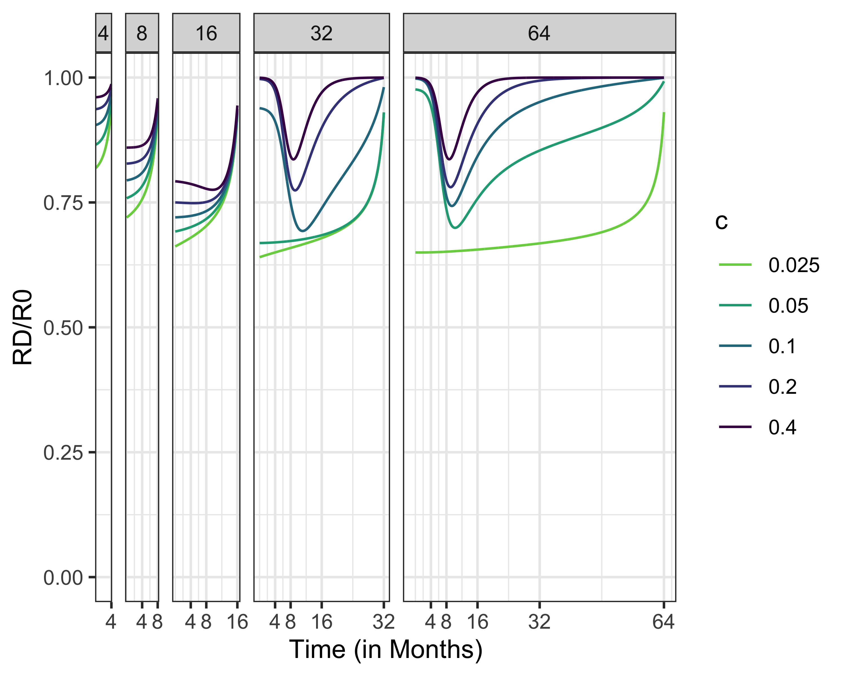
Social Distancing Policies, R0 = 1.5

Slide 40
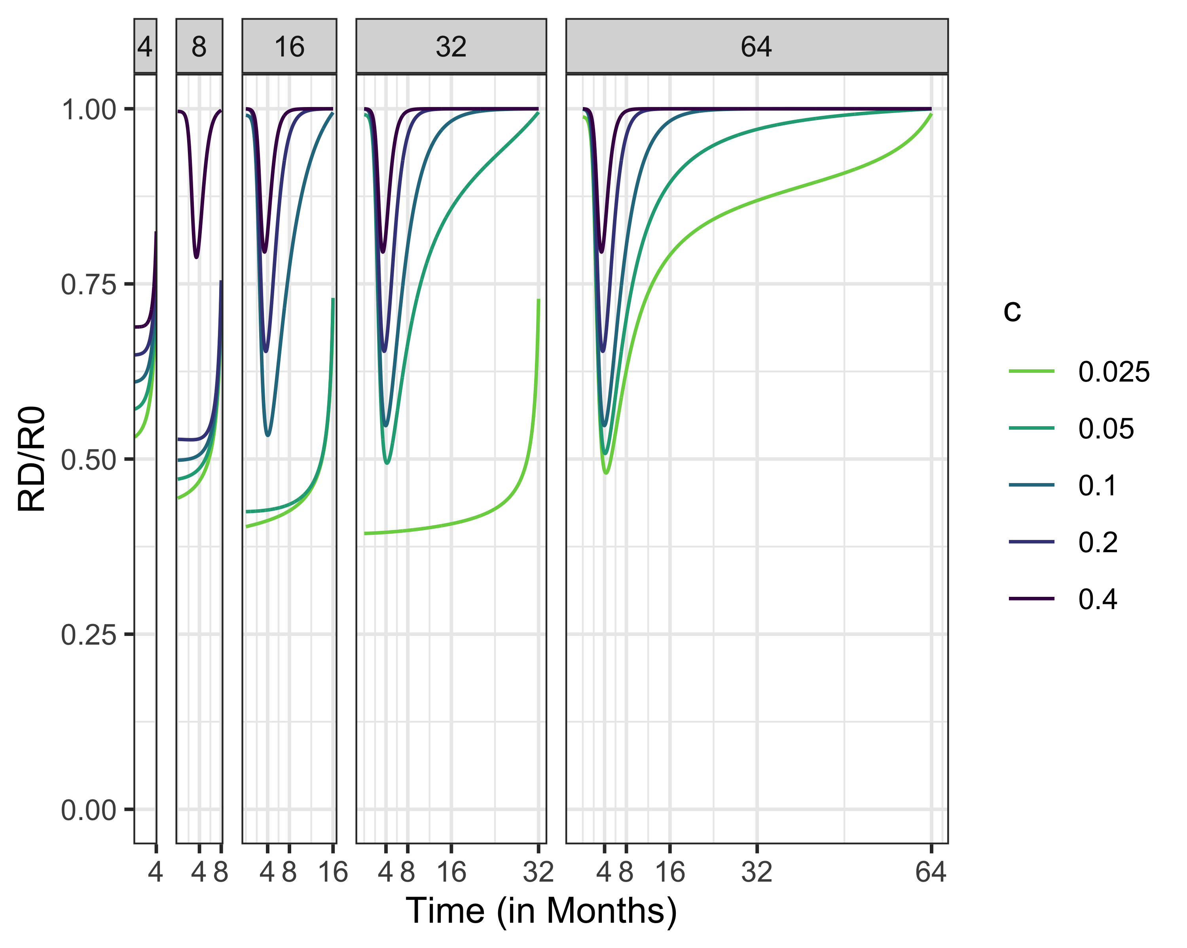
Social Distancing Policies, R0 = 2.5

Slide 41
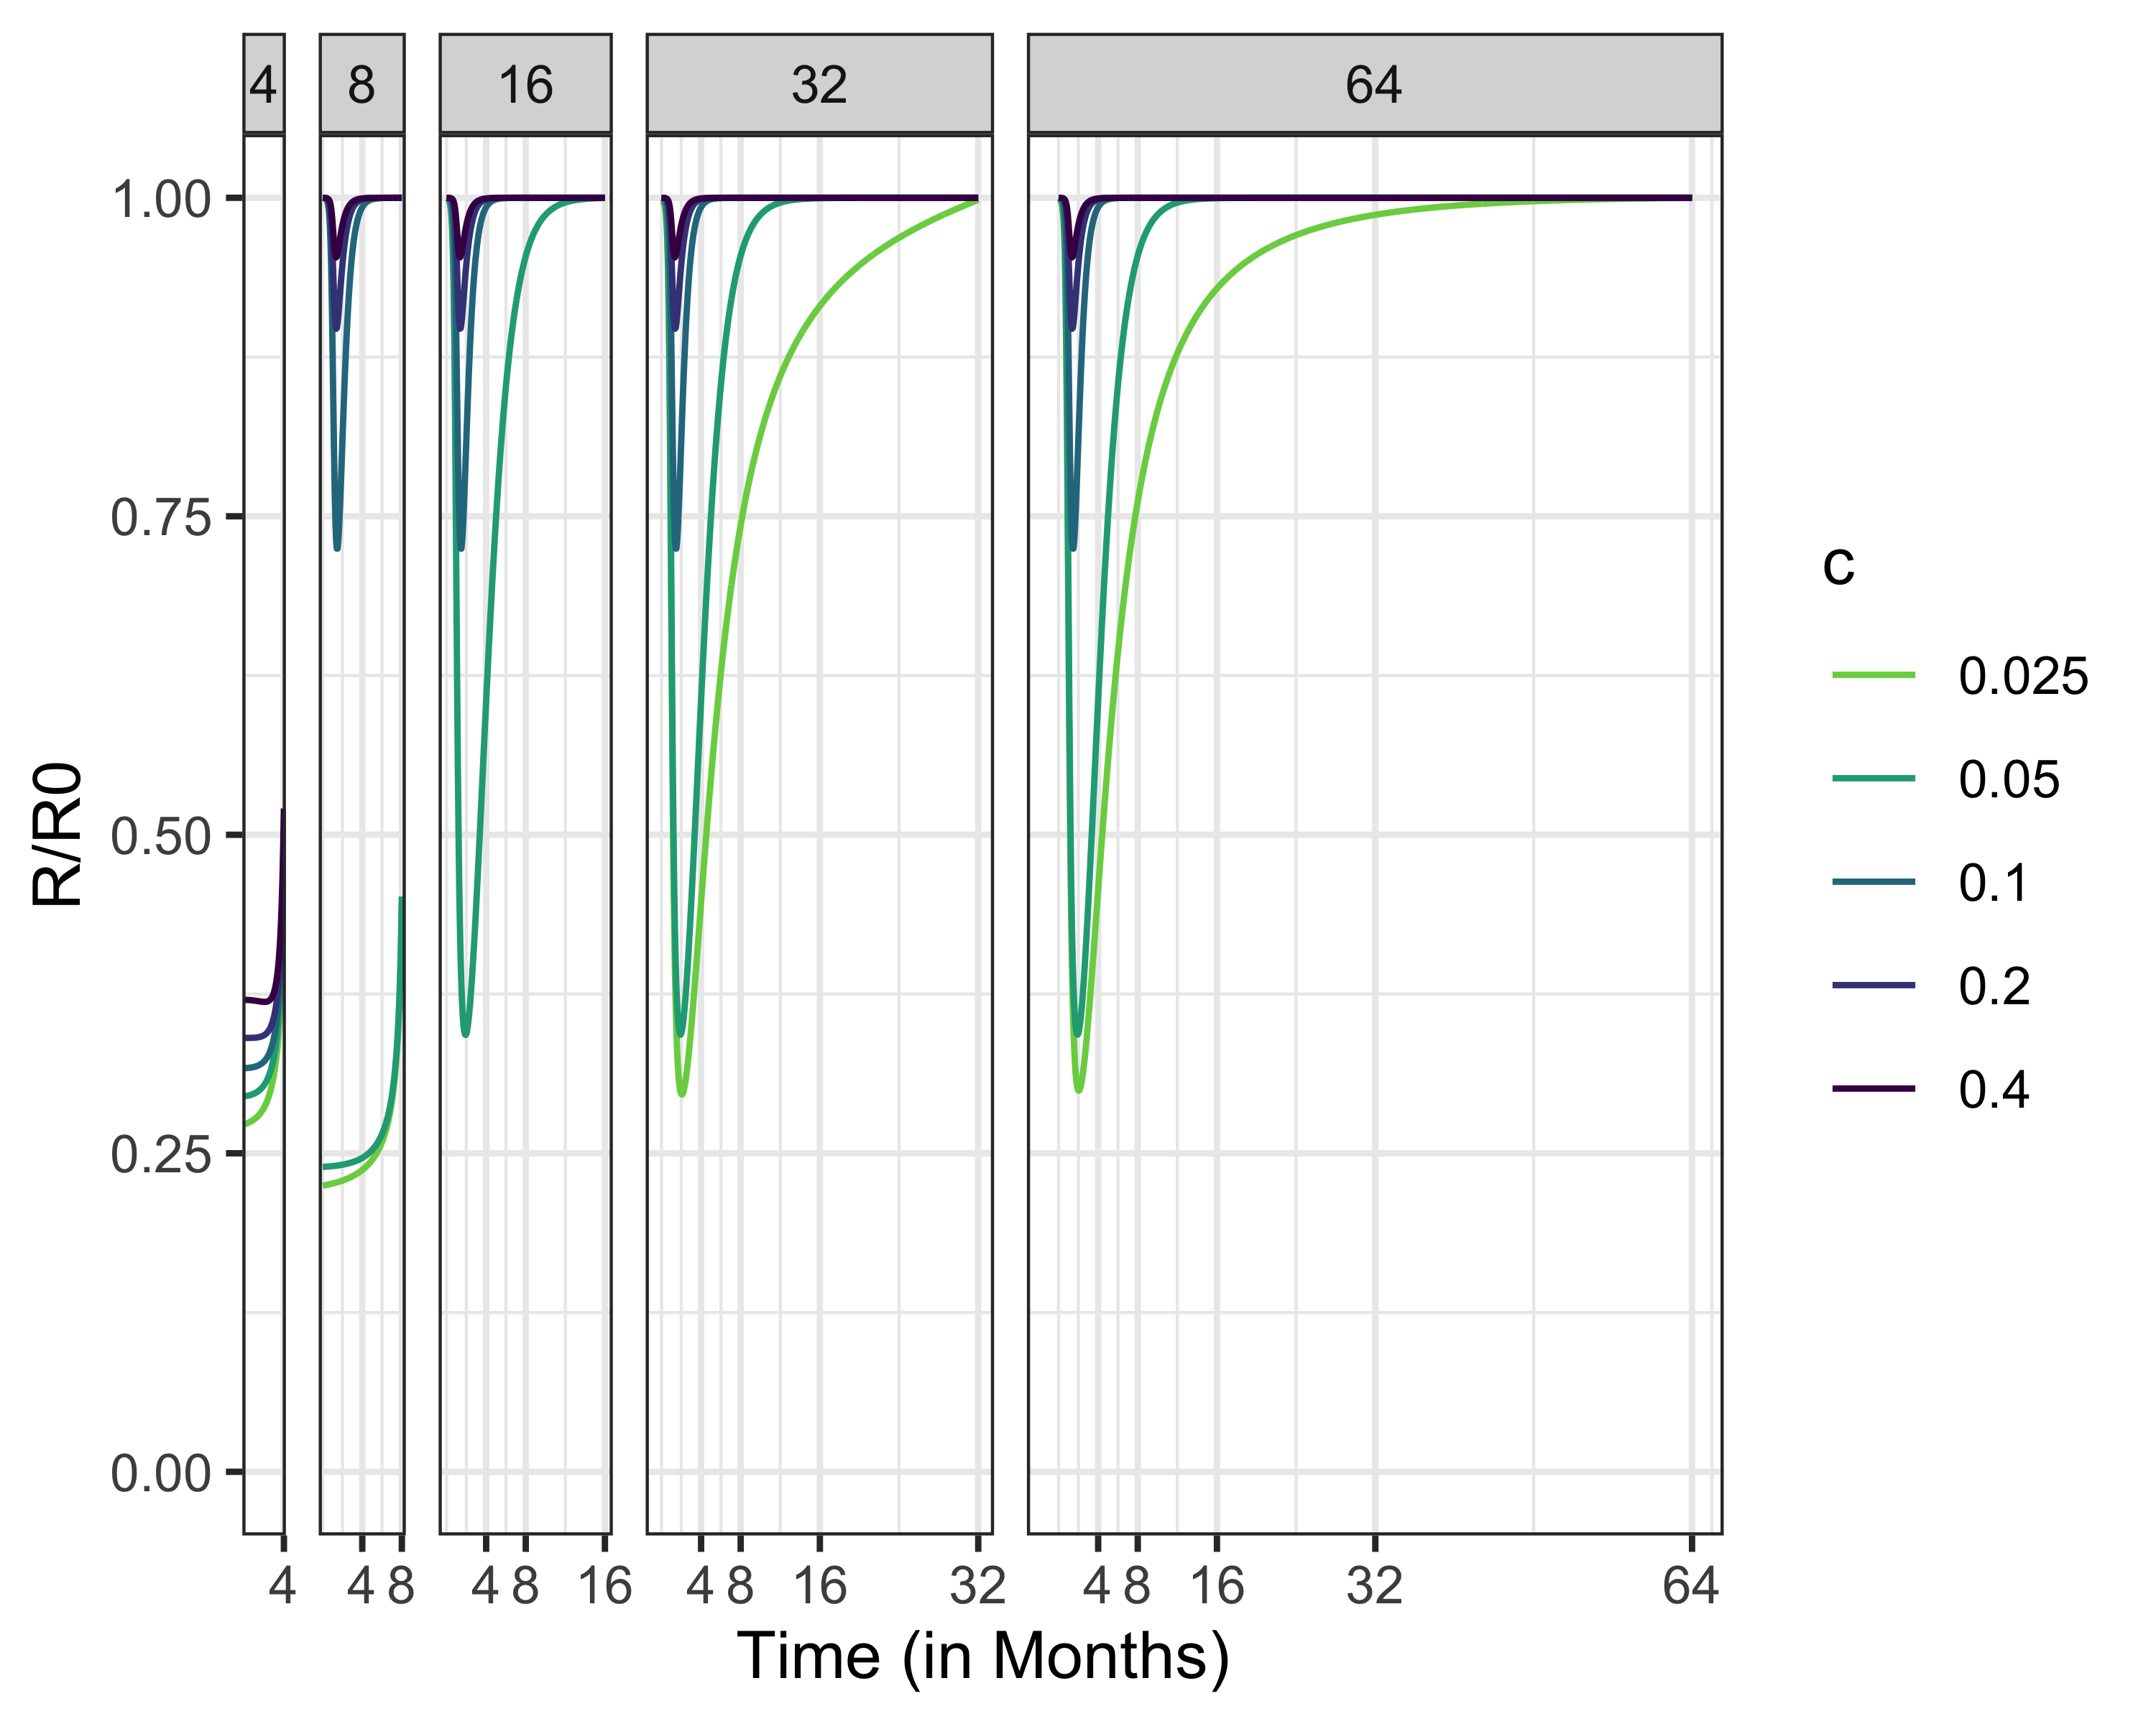
Social Distancing Policies, R0 = 5

Slide 42
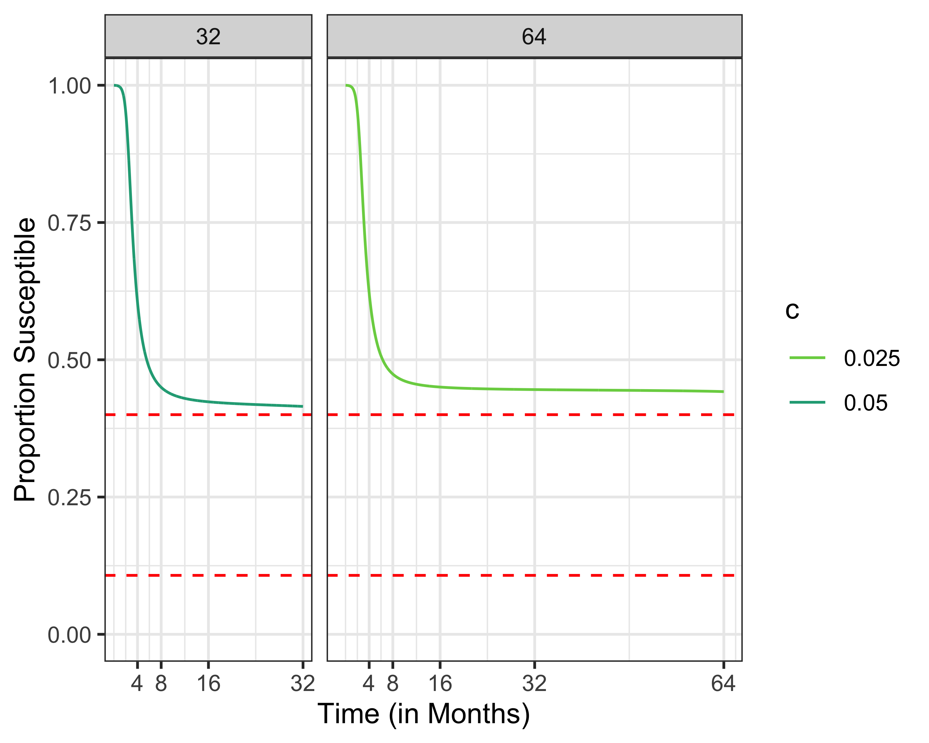
Intermediate Policies Between Mitigation and Suppression

Slide 43
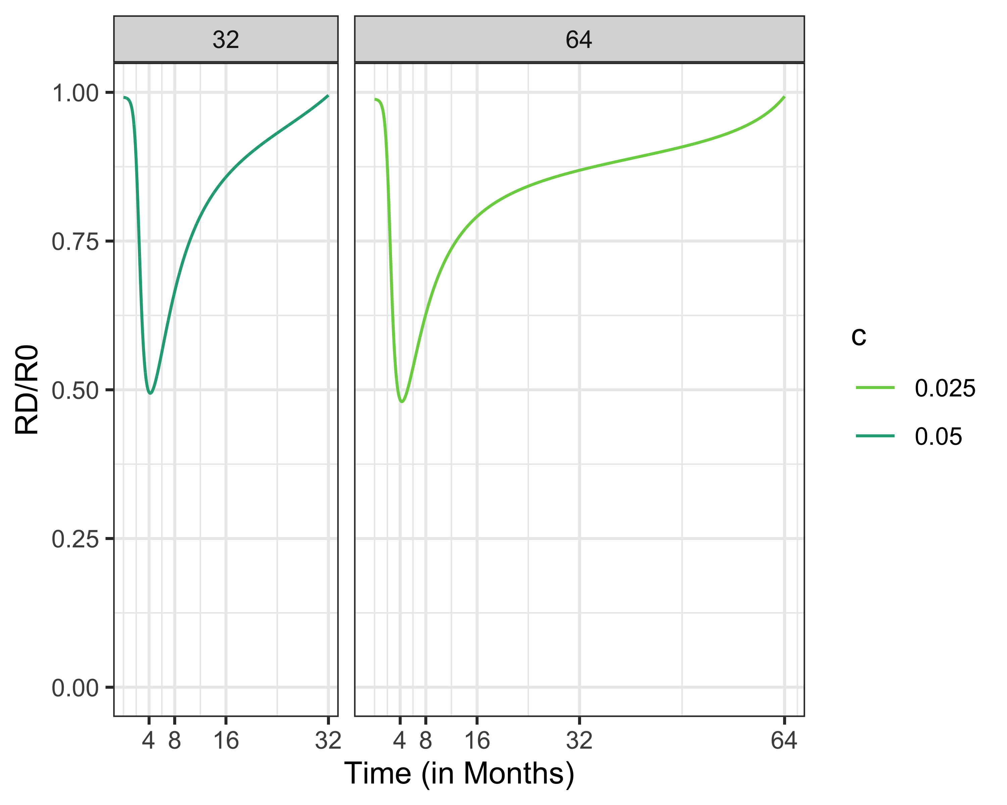
Intermediate Policies Between Mitigation and Suppression

Slide 44
What If Policy/Behavior Is Based On Current Risk Only?
Instead of considering what is best over the entire time period, weigh:
Risk of getting infected TODAY vs.
Cost of social distancing TODAY
This strategy ignores long-term control (i.e., benefit of social distancing if cases are low but rising)

Slide 45
Recall: Suppression Policies When Cost of Social Distancing Is Low

Slide 46
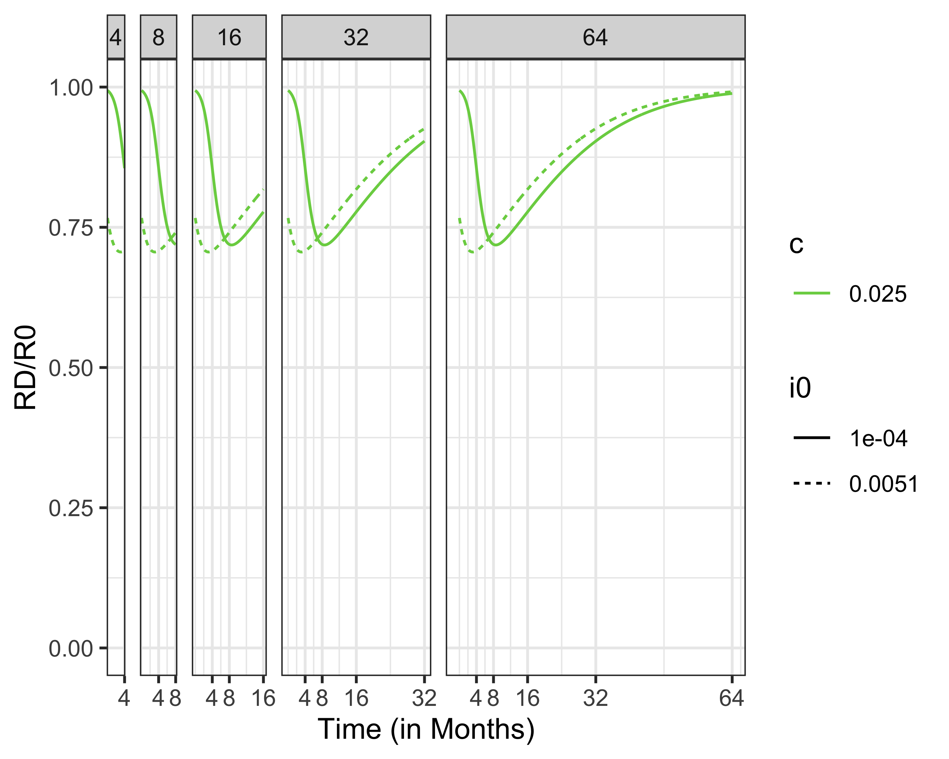
Policies Not Considering Long-Term Benefit of Social Distancing

Slide 47
Recall: Susceptibles When Considering Long-Term Benfits of Social Distancing

Slide 48
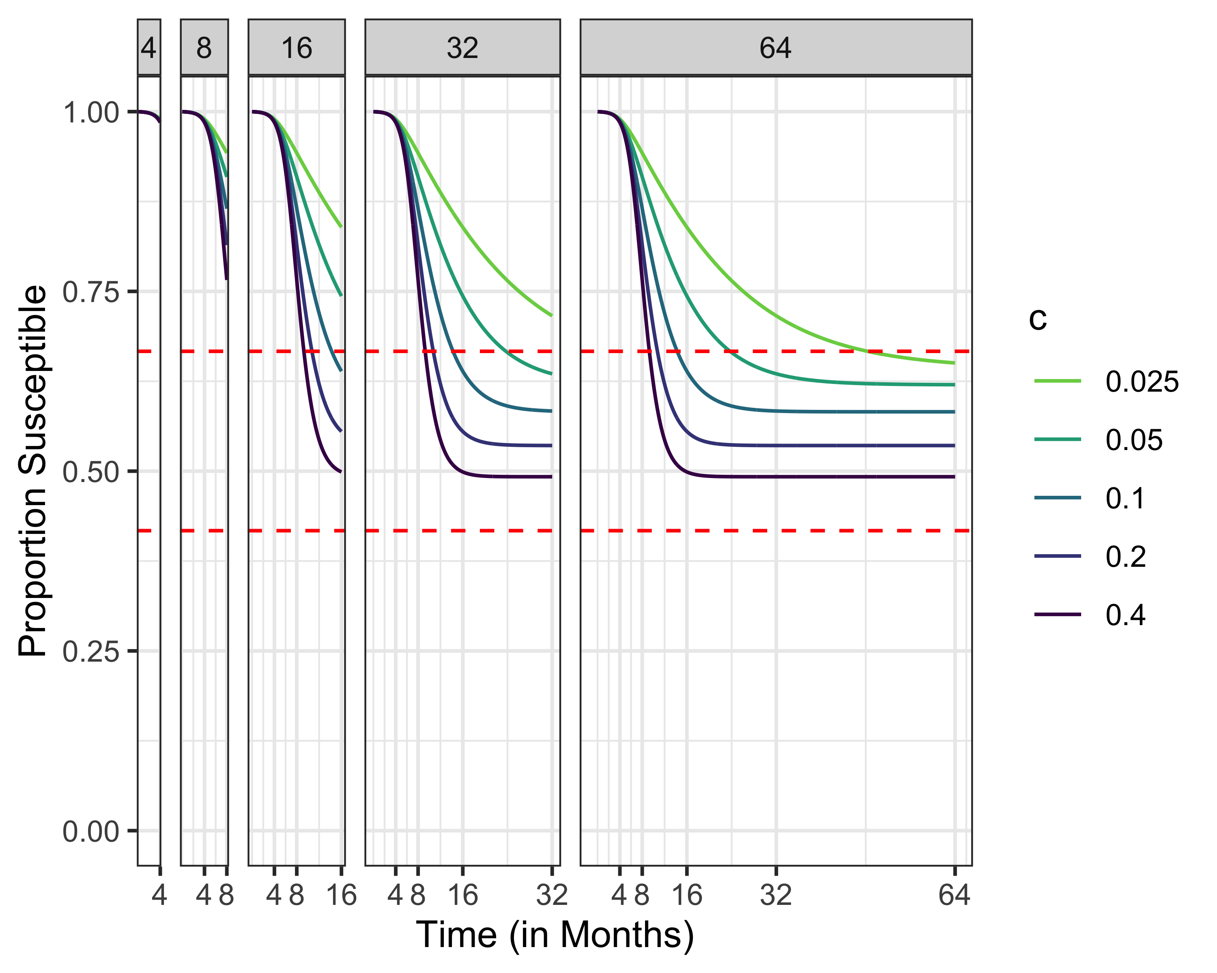
Policies When Considering Only Current Risk of Infection

Slide 49
Next Steps
Model can be generalized to consider:
SEIR, SIRS, SEIRS
Multiple population groups (low-risk, high risk)
Birth/death processes
Requires solving an 2pt boundary value problem “easy”

Slide 50
Acknowledgements
Raffaele Vardavas, PhD
Pedro Lima

